Slide 1




COVID-19 CARES ACT &
Consolidated Appropriations Act, 2021
Policy Designed by Small Business Administration
Presented by:
Virginia Highlands Small Business Development Center

Slide 2
SBDC Regional Staff
Free assistance with reconstructing financial records, preparing financial statements and submitting the loan application is available from any of SBA’s partners: Small Business Development Centers (SBDCs), SCORE, Women’s Business Centers (WBC), and Veteran’s Business Outreach Centers and local Chambers of Commerce.
Cindy Fields, Virginia Highlands Small Business Development Center, Serving City of -Bristol, Smyth and Washington Counties. Phone 276-739-2515
E-Mail: cfields2@vhcc.edu
Mandy Archer, Blue Ridge Crossroads SBDC, Serving City of Galax, Bland, Carroll, and Grayson, Counties. Phone 276-601-7727 E-Mail: SbdcDirector@brceda.org
Margie Douglass, Southwest Virginia Community College, Serving Buchanan, Dickenson, Russell, and Tazewell Counties. Phone: 276-964-7345 or 276-964-7337
E-Mail: margie.douglass@sw.edu
Tim Blankenbecler, Mountain Empire Community College, Serving City of Norton, Lee, Scott, and Wise Counties. Phone 276-739-2515 or 276-964-7345

Slide 3
Preliminary Consolidated COVID-19 Relief Bill
The legislation, the Consolidated Appropriations Act, 2021, includes the following provisions:
A total of $300 billion has been set aside for small business assistance
501(c)(6) not-for-profit organizations will be eligible
$284 billion has been included for the PPP program
$20 billion will be used to replenish the EIDL “first advance” program for businesses in low-income communities
Closed live-venues, independent movie theaters, and cultural institutions can access a pool of $15 billion
$12 billion will be set aside for businesses in low-income and minority communities
PPP2 will be available to borrowers that did not receive assistance from PPP1 and borrowers that did receive funds from the original PPP
PPP2 recipients can receive up to $2 million if they meet the following criteria:
  300 or fewer employees
  Have used or will use the full amount of their first PPP loan
  Can show a 25% revenue decline in any 2020 quarter compared to the same period in 2019

Slide 4
Preliminary Consolidated COVID-19 Relief Bill (Continued)
501(c)(6) must also meet these criteria, as well as prove that no more than 15% of their total activities and have cost no more than $1 million during the most recent tax year ending prior to 2/15/2020
PPP2 will also permit first-time borrowers from the following groups:
  Businesses with 500 or fewer employees that are eligible for other SBA 7(a) loans
  Sole proprietors, independent contractors, and eligible self-employed individuals
  Not-for-profits, including churches
  NAICS codes starting with 72 with fewer than 300 employees per location
Borrowers that returned all or part of a previous PPP loan can re-apply for the maximum available to them
In addition to the eligible costs under PPP1, the new Act will provide forgiveness for the following:
  Covered worker protection and facility modification expenditures, including PPE, to comply with COVID-19 federal health and safety guidelines
  Expenditures to suppliers that are essential at the time of purchase
  Covered operating costs, including software and cloud computing and accounting needs

Slide 5
Preliminary Consolidated COVID-19 Relief Bill (Continued)
As with PPP1, borrowers must spend 60% of the funds on payroll over a covered period of either 8 or 24 weeks
Also, borrowers can receive up to 2.5X average monthly payroll, up to $2 million, except for NAICS code 72 entities, which can get 3.5X their average payroll costs, up to $2 million

Slide 6
Preliminary Consolidated COVID-19 Relief Bill (Continued)
PPP forgiveness for loans of $150,000 or less has been further simplified so that all that will be needed is a 1-page certification that includes the following:
  The number of employees the borrower was able to retain because of the loan
  The estimated total amount of the loan spent on payroll
  The total loan amount
The certification document must be produced by the SBA within 24 days of the bill’s enactment and may not require additional materials unless necessary to substantiate revenue loss requirements
  Borrowers must retain relevant records related to employment for 4 years and other records for 3 years in the event the agency wants to check for fraud
  Repeals the requirement that PPP borrowers deduct the amount of their EIDL first advance from their PPP forgiveness amount
  Set asides included to support borrowers with 10 or fewer employees, first-time PPP borrowers made eligible under the new guidelines, and loans made by community lenders
  Business expenses paid with forgiven PPP loans will be tax-deductible
It now also appears that the Pandemic Unemployment will be extended.

Slide 7
Timeline of Bill
The President signed the Pandemic Relief Bill 12/27/20
SBA and Treasury should release guidance within 10 days for lenders and borrowers.
Lending Community will have to accept terms of the loan application before they open portals.
SBDC will offer more detailed webinars around the middle of January 2021.

Slide 8
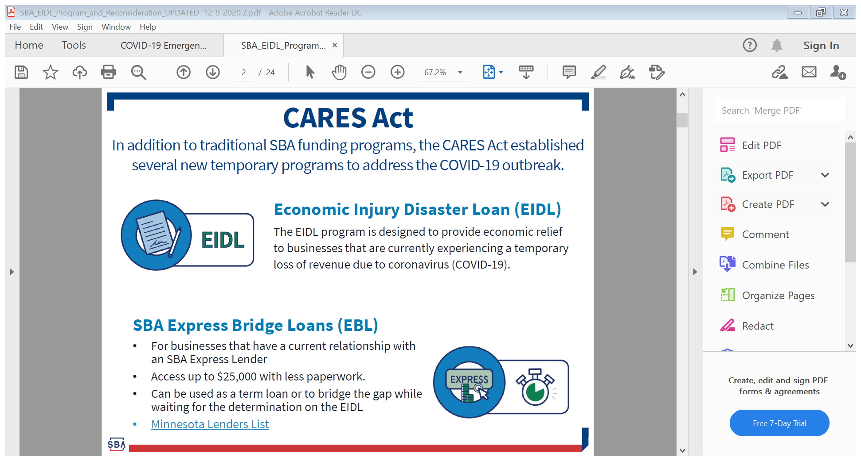

Slide 9
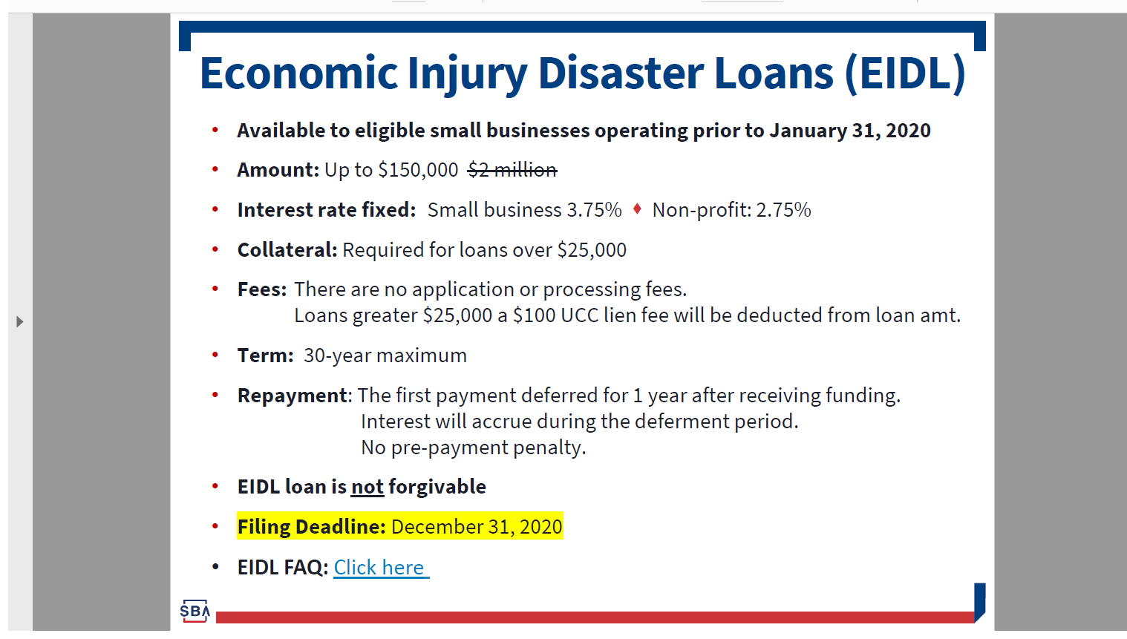
Link to apply for the loan –
https://covid19relief.sba.gov/#/

Slide 10
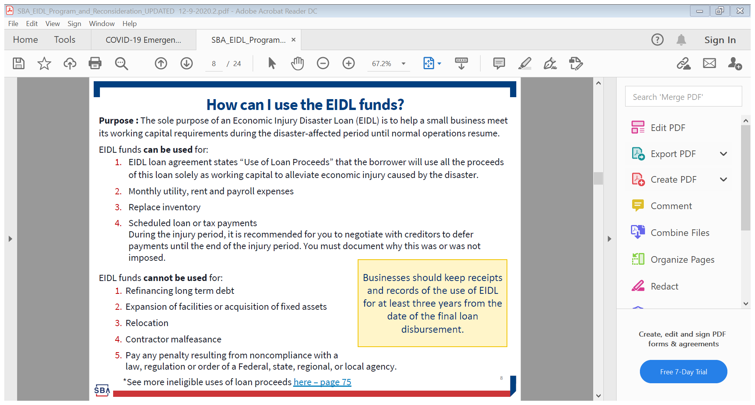

Slide 11
Changes to EIDL Program – 12/22/20
The re-funding of the EIDL “first advance” program with $20 billion in additional funding. Of particular note are the following:
  If an EIDL applicant did not receive the first advance because the program ran out of funds (mid -July), they will now be eligible for funding
  If an EIDL applicant received less than $10,000 (based on the prior formula of $1,000 per employee, up to $10,000) they will now be eligible to receive the additional funds (the difference between $10,000 and the actual amount received)
Under earlier versions of the PPP loan, if a borrower also received an EIDL first advance, then the amount of the first advance would be deducted from the amount of PPP forgiven, which would, therefore, result in many borrowers ending up with a small-balance PPP loan. The new legislation reversed this requirement so that entities that received both an EIDL first advance and a PPP loan will no longer have the EIDL amount deducted from the amount of PPP debt forgiven
EIDL first advances will no longer be considered taxable income
These changes are good news for a lot of small businesses and other eligible entities. However, these changes will require the SBA to create a process by which borrowers and lenders have already processed their forgiveness applications. Also, some borrowers have also repaid their residual PPP balances, and these will need to be addressed as well. To date, fully 21% of small businesses have applied for partial forgiveness, primarily because they also received EIDL first advances. This could result in hundreds of thousands of small businesses will receive full PPP forgiveness, based on both loans already forgiven as well as those that will apply for loans under the new round of PPP funding. This information could be helpful to SBDC clients in the coming months as they sort thru existing PPP debts as well as they seek funding from the new round of PPP.

Slide 12
If you have been denied for an EIDL Loan and are still within the 6 month window, contact your SBDC office for guidance on how to appeal the decision.
Contact your SBDC Office for assistance with this process.

Slide 13
How to Report SBA Disaster Loan Fraud
National Center for Disaster Fraud Hotline at 1-866-720-5721or fill out the web complaint form via:
https://www.justice.gov/disaster-fraud/ncdf-disaster-complaint-form
Report fraud, waste, abuse, or mismanagement of federal funds involving SBA programs, operations, or personnel to the SBA OIG Hotline at (800) 767-0385. or submit a complaint form via:
https://www.sba.gov/about-sba/oversight-advocacy/office-inspector-general/office-inspector-general-hotline#section-header-0
You may also contact your local SBA office or SBDC office.

Slide 14
Beware of COVID Phishing Emails!
Cyber Threat Intelligence assess that phishing activity by cyber criminals has increased.
SBA does not initiate contact on Disaster loans. If you are proactively contacted by someone claiming to be from the SBA-suspect fraud.
Any email from the SBA will end with “sba.gov”
Report any suspected fraud to SBA OIG Hotline at (800) 767-0385. or submit a complaint form via:
https://www.sba.gov/about-sba/oversight-advocacy/office-inspector-general/office-inspector-general-hotline#section-header-0
Find out more:
SBA Programs -Scams and Fraud Alerts
23

Slide 15
CARES Act
Small Business Financial Assistance
EIDL Grant (Applications Now CLOSED)
EIDL Program enhancements (Applications Now CLOSED)
EBL – Express Bridge Loan Pilot Program
Small Business Debt Relief
Payroll Protection Program (Current Appropriations Have Been Exhausted)
Small Business Tax Provisions
NEW SBA Website
https://covid19relief.sba.gov/#/
VirginiaSBDC.org
Notes:
Encourage patience and help in managing business’ expectations. The rules and regulations will take up to 15 days (or longer) to be developed and released; and, there are some technical changes that will need to be made because the legislation was put together so quickly.
But, SBA did put up a new website over the weekend for EIDL and it does reflect the enhancements included in the CARES Act.

Slide 16
Economic Injury Disaster Loan (EIDL) and EIDL Grant Expanded in CARE Acts
EIDL Grant
  Latest Update from SBA Site – Lapse in Appropriations will NOT ACCEPT NEW APPLICATIONS AT THIS TIME!
  submit EIDL application, ask for the advance—check box on EIDL application
  up to $10,000 ($1,000 per employee); 3-days after submitting an EIDL application
  does not need to be repaid under any circumstance
  Will offset the PPP portion forgiven
EIDL
Eligibility
  Businesses with up to 500 employees in operation as of Feb 15, 2020
  Nonprofit organizations with fewer than 500 employees – 501c, d, e
  Independent contractors and sole proprietors
Loans from SBA directly
  Waives personal guarantees and 1-year in business for advances and loans under $200,000
  Do not need to have sought capital elsewhere for advances and loans under $200,000
  No collateral for $25k or less
  Up to 12 month deferral on loan payments; interest will begin accruing upon disbursement
Loan Amounts
  Working capital loan up to $2 million; Based on 2 months operating expenses; Max $15k
  Term 30 years, 3.75%
Uses for the loan proceeds include:
  Payroll, working capital, operating expenses
Notes:
Economic Injury Disaster Loan (EIDL) and EIDL Grant Expanded in CARE Acts
EIDL Grant – up to $10,000 3-days after submitting an EIDL application; submit EIDL application , ask for the advance. It does not need to be repaid under any circumstance; can be used to keep emps on payroll, pay for sick leave, other operational exps; in business since Jan 31, 2020; if you already have an EIDL Loan up to $10K can be forgiven.
Eligibility
Harmed by COVID-19
Businesses with up to 500 employees in operation as of Feb 15, 2020
Nonprofit organizations with fewer than 500 employees – 501c, d, e
Independent contractors and sole proprietors
Loans from SBA directly
Waives personal guarantees and 1-year in business for advances and loans under $200,000
Do not need to have sought capital elsewhere for advances and loans under $200,000
No collateral for $25k or less
Loan Amounts
Working capital loan up to $2 million
Based on 6 months operating expenses
Uses for the loan proceeds include:
Payroll, working capital, operating expenses

Slide 17
Express Bridge Loan Pilot Program
For businesses with an existing relationship with an SBA Express Lender
Up to $25,000
Fast Turn around
Will be repaid in part or full by proceeds from the EIDL Loan
Not All Banks Are Offering This Program
Small Business Debt Relief Program
immediate relief to small businesses with non-disaster SBA loans
SBA will cover payments for six months.
also be available to new borrowers who take out loans within six months of the President signing the bill into law
Notes:
Economic Injury Disaster Loan (EIDL) and EIDL Grant Expanded in CARE Acts
EIDL Grant – up to $10,000 3-days after submitting an EIDL application; submit EIDL application , ask for the advance. It does not need to be repaid under any circumstance; can be used to keep emps on payroll, pay for sick leave, other operational exps; in business since Jan 31, 2020; if you already have an EIDL Loan up to $10K can be forgiven.
Eligibility
Harmed by COVID-19
Businesses with up to 500 employees in operation as of Feb 15, 2020
Nonprofit organizations with fewer than 500 employees – 501c, d, e
Independent contractors and sole proprietors
Loans from SBA directly
Waives personal guarantees and 1-year in business for advances and loans under $200,000
Do not need to have sought capital elsewhere for advances and loans under $200,000
No collateral for $25k or less
Loan Amounts
Working capital loan up to $2 million
Based on 6 months operating expenses
Uses for the loan proceeds include:
Payroll, working capital, operating expenses

Slide 18
Paycheck Protection Program (Program Has Currently Closed)
Eligibility
  Available through June 30, 2020 or until funds are exhausted
  Businesses with up to 500 employees in operation as of Feb 15, 2020
  Nonprofits, independent contractors and sole proprietors
Loans from SBA approved banks, credit unions, and some nonbank lenders
No collateral; no personal guarantees; do not need to have sought capital elsewhere
Loan Amount
  2.5 times monthly payroll expenses Feb 15, 2019 – June 30, 2019, up to $10m
Uses for the loan proceeds include:
  qualified payroll costs; rent; utilities; and interest on mortgage and other debt obligations. MAKE SURE YOU KEEP GOOD DOCUMENTATION!
Loan Forgiveness
  for funds used to pay 8 weeks of payroll (excluding salary in excess of $100,000)
  8 weeks begins on the loan origination date
Loan amount that is not forgiven
  max interest rate is 4% (Fed Rate is 1.0%) and max term is 2 years
  principle and interest deferred for 6 months with interest beginning to accrue when payment is disbursed.
Notes:
Paycheck Protection Program
Eligibility
Businesses with up to 500 employees in operation as of Feb 15, 2020
Nonprofit organizations – 501c(3) with fewer than 500 employees
Independent contractors and sole proprietors
Loans from SBA approved banks, credit unions, and some nonbank lenders
No collateral; no personal guarantees; do not need to have sought capital elsewhere and been declined
Loan Amounts
2.5 times their monthly payroll expenses Feb 15, 2019 – June 30-2019, up to $10m
In biz - Feb 15 2019-June 30 2019 - 2.5 times the average monthly payroll costs for the period
Not in biz Feb 2019-June 30 2019 – 2.5 x average monthly payroll costs between Jan 1 2020 and Feb 29 2020
Uses for the loan proceeds include:
(1) qualified payroll costs; (2) rent; (3) utilities; and (4) interest on mortgage and other debt obligations.
What costs are eligible for payroll?
Compensation (salary, wage, commission, or similar compensation, payment of cash tip or equivalent) – up to $100,000 per employee or owner
Payment for vacation, parental, family, medical, or sick leave
Allowance for dismissal or separation
Payment required for the provisions of group health care benefits, including insurance premiums
Payment of any retirement benefit
Payment of State or local tax assessed on the compensation of employees
Loan Forgiveness
Loan forgiven for funds used to pay 8 weeks of payroll (excluding sal in excess of $100,000) plus any payment of interest on any covered mortgage obligation (not including any prepayment or payment of principal on a covered mortgage obligation) plus any payment on any covered rent obligation plus and any covered utility payment.
The 8 week period begins on the loan origination date
Employee reductions from Feb 15 and ending 30 days after enactment of CARES Act will not reduce loan forgiveness
Loan amount that is not forgiven
max interest rate is 4% and max term is 10 years
prin and int deferred for 6-12 months after disbursement of the loan

Slide 19
Paycheck Protection Program
What Renders A Business Ineligible? Answering “Yes” to the following questions
Is the Applicant or any owner of the Applicant presently suspended, debarred, proposed for debarment, declared ineligible, voluntarily excluded from participation in this transaction by any Federal department or agency, or presently involved in any bankruptcy?
Has the Applicant, any owner of the Applicant, or any business owned or controlled by any of them, ever obtained a direct or guaranteed loan from SBA or any other Federal agency that is currently delinquent or has defaulted in the last 7 years and caused a loss to the government?
Is the Applicant (if an individual) or any individual owning 20% or more of the equity of the Applicant subject to an indictment, criminal information, arraignment, or other means by which formal criminal charges are brought in any jurisdiction, or presently incarcerated, or on probation or parole?
Within the last 5 years, for any felony, has the Applicant (if an individual) or any owner of the Applicant 1) been convicted; 2) pleaded guilty; 3) pleaded nolo contendere; 4) been placed on pretrial diversion; or 5) been placed on any form of parole or probation (including probation before judgment)?
Notes:
Paycheck Protection Program
Eligibility
Businesses with up to 500 employees in operation as of Feb 15, 2020
Nonprofit organizations – 501c(3) with fewer than 500 employees
Independent contractors and sole proprietors
Loans from SBA approved banks, credit unions, and some nonbank lenders
No collateral; no personal guarantees; do not need to have sought capital elsewhere and been declined
Loan Amounts
2.5 times their monthly payroll expenses Feb 15, 2019 – June 30-2019, up to $10m
In biz - Feb 15 2019-June 30 2019 - 2.5 times the average monthly payroll costs for the period
Not in biz Feb 2019-June 30 2019 – 2.5 x average monthly payroll costs between Jan 1 2020 and Feb 29 2020
Uses for the loan proceeds include:
(1) qualified payroll costs; (2) rent; (3) utilities; and (4) interest on mortgage and other debt obligations.
What costs are eligible for payroll?
Compensation (salary, wage, commission, or similar compensation, payment of cash tip or equivalent) – up to $100,000 per employee or owner
Payment for vacation, parental, family, medical, or sick leave
Allowance for dismissal or separation
Payment required for the provisions of group health care benefits, including insurance premiums
Payment of any retirement benefit
Payment of State or local tax assessed on the compensation of employees
Loan Forgiveness
Loan forgiven for funds used to pay 8 weeks of payroll (excluding sal in excess of $100,000) plus any payment of interest on any covered mortgage obligation (not including any prepayment or payment of principal on a covered mortgage obligation) plus any payment on any covered rent obligation plus and any covered utility payment.
The 8 week period begins on the loan origination date
Employee reductions from Feb 15 and ending 30 days after enactment of CARES Act will not reduce loan forgiveness
Loan amount that is not forgiven
max interest rate is 4% and max term is 10 years
prin and int deferred for 6-12 months after disbursement of the loan

Slide 20
Paycheck Protection Program
Average Payroll Calculation
Notes:
Paycheck Protection Program
Eligibility
Businesses with up to 500 employees in operation as of Feb 15, 2020
Nonprofit organizations – 501c(3) with fewer than 500 employees
Independent contractors and sole proprietors
Loans from SBA approved banks, credit unions, and some nonbank lenders
No collateral; no personal guarantees; do not need to have sought capital elsewhere and been declined
Loan Amounts
2.5 times their monthly payroll expenses Feb 15, 2019 – June 30-2019, up to $10m
In biz - Feb 15 2019-June 30 2019 - 2.5 times the average monthly payroll costs for the period
Not in biz Feb 2019-June 30 2019 – 2.5 x average monthly payroll costs between Jan 1 2020 and Feb 29 2020
Uses for the loan proceeds include:
(1) qualified payroll costs; (2) rent; (3) utilities; and (4) interest on mortgage and other debt obligations.
What costs are eligible for payroll?
Compensation (salary, wage, commission, or similar compensation, payment of cash tip or equivalent) – up to $100,000 per employee or owner
Payment for vacation, parental, family, medical, or sick leave
Allowance for dismissal or separation
Payment required for the provisions of group health care benefits, including insurance premiums
Payment of any retirement benefit
Payment of State or local tax assessed on the compensation of employees
Loan Forgiveness
Loan forgiven for funds used to pay 8 weeks of payroll (excluding sal in excess of $100,000) plus any payment of interest on any covered mortgage obligation (not including any prepayment or payment of principal on a covered mortgage obligation) plus any payment on any covered rent obligation plus and any covered utility payment.
The 8 week period begins on the loan origination date
Employee reductions from Feb 15 and ending 30 days after enactment of CARES Act will not reduce loan forgiveness
Loan amount that is not forgiven
max interest rate is 4% and max term is 10 years
prin and int deferred for 6-12 months after disbursement of the loan

Slide 21
Important Information to Discuss With Your Lender at Closing of PPP Loan
If I get or have gotten the Advance – does that deduct from any PPP loan forgiveness that I might qualify for?
If I get or have gotten the EIDL Loan – does that roll in to the PPP loan and get refinanced over 2 years at 1%; how do I report that to you and do we do a re-finance on documents at that point as I have applied but not heard anything yet.
If I get or have gotten the EIDL Loan – Does the EIDL loan total get added to the PPP as the denominator in calculating if I spent 75% on Payroll Costs in determining forgiveness? If so, should I spend some of the EIDL on payroll costs to get me to the 75%?

Slide 22
Paycheck Protection Program
Documents Needed For Businesses
  IRS Quarterly 940, 941 or 944 payroll tax report for 2019 to present
  IRS W-3 Wage and Tax Statement
  Payroll Summary that Shows Gross Wages to Reconcile to the 941
  Payroll documentation showing you were an active business on or around Feb 15 (payroll processor records, payroll tax filings, etc.)
  Legal Documents for the Company (Articles, By-Laws, Operating Agreement, etc)
  Copies of Drivers License for any Company Owner 25% or Greater
  Profit and Loss Statement for the Last 12 months (2019 Tax Returns can be Substituted for 2019 P and L)
  Mortgage and Rent Statements
  Utilities Bills
  ***Please note that other items may be required as further guidance is issued to banks from the SBA
Documents Needed For Independent Contractors/Sole Proprietors
  2019 Schedule C
  2019 1099
  Statement that you were in Business at 2/15/20 (i.e. Invoice, Bank Statement,etc.)
Notes:
Paycheck Protection Program
Eligibility
Businesses with up to 500 employees in operation as of Feb 15, 2020
Nonprofit organizations – 501c(3) with fewer than 500 employees
Independent contractors and sole proprietors
Loans from SBA approved banks, credit unions, and some nonbank lenders
No collateral; no personal guarantees; do not need to have sought capital elsewhere and been declined
Loan Amounts
2.5 times their monthly payroll expenses Feb 15, 2019 – June 30-2019, up to $10m
In biz - Feb 15 2019-June 30 2019 - 2.5 times the average monthly payroll costs for the period
Not in biz Feb 2019-June 30 2019 – 2.5 x average monthly payroll costs between Jan 1 2020 and Feb 29 2020
Uses for the loan proceeds include:
(1) qualified payroll costs; (2) rent; (3) utilities; and (4) interest on mortgage and other debt obligations.
What costs are eligible for payroll?
Compensation (salary, wage, commission, or similar compensation, payment of cash tip or equivalent) – up to $100,000 per employee or owner
Payment for vacation, parental, family, medical, or sick leave
Allowance for dismissal or separation
Payment required for the provisions of group health care benefits, including insurance premiums
Payment of any retirement benefit
Payment of State or local tax assessed on the compensation of employees
Loan Forgiveness
Loan forgiven for funds used to pay 8 weeks of payroll (excluding sal in excess of $100,000) plus any payment of interest on any covered mortgage obligation (not including any prepayment or payment of principal on a covered mortgage obligation) plus any payment on any covered rent obligation plus and any covered utility payment.
The 8 week period begins on the loan origination date
Employee reductions from Feb 15 and ending 30 days after enactment of CARES Act will not reduce loan forgiveness
Loan amount that is not forgiven
max interest rate is 4% and max term is 10 years
prin and int deferred for 6-12 months after disbursement of the loan

Slide 23
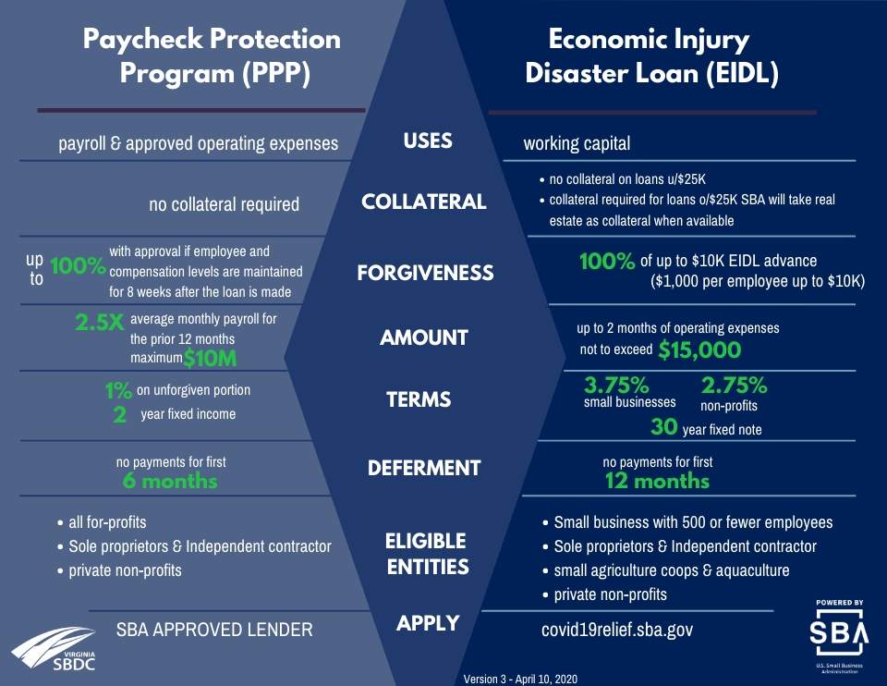

Slide 24
Small Business Tax Provisions
Employee Retention Credit for Employers Subject to Closure or Experiencing Economic Hardship
Refundable payroll tax credit for 50% of wages; It appears this will increase to 70% of wages for 1/1/21- 6/30/21 with some additional expanded eligibility.
Delay of Payment of Employer Payroll Taxes
2020 Payroll tax deferment until December 2021 and December 2022

Slide 25
Unemployment Benefits Through CARES ACT
Key Takeaways
Federal Pandemic Unemployment Compensation (FPUC) is an emergency program established by the CARES Act to increase unemployment benefits for Americans who are out of work because of the COVID-19 pandemic.
Under FPUC, eligible people who collect certain unemployment insurance benefits—including regular unemployment compensation—will get an extra $600 in federal benefits each week through July 31, 2020 NOW EXTENED DETAILS TO FOLLOW.
The CARES Act also established the Pandemic Emergency Unemployment Compensation (PEUC) program, which extends unemployment benefits for an extra 13 weeks, and the Pandemic Unemployment Assistance (PUA) program, which expands unemployment insurance eligibility to self-employed workers, freelancers, independent contractors, and part-time workers impacted by the coronavirus.

Slide 26
Alternative Funding Options
Opportunity SWVA Resource Page: http://www.opportunityswva.org/covid-19-resources-and-assistance-for-small-businesses-and-startups/
Norton Strong Community Loan Fund: http://www.nortonva.gov/nortonstrong
Crowdfunding Options:
Intuit GoFundMe: https://quickbooks.intuit.com/small-business/coronavirus/#sectiongofundme
Here is an announcement from Intuit highlighting three products we created specifically to address the needs we were hearing of both small businesses and individuals as we navigate this uncertain time - Intuit Aid Assist, QuickBooks Capital for Paycheck Protection Program, and TurboTax Stimulus Registration.
Kiva Small Business Loans 0% Intresst: https://www.kiva.org/borrow
WeFounder 0% Loan Fund: https://wefunder.com/loans
Verison Fund https://www.lisc.org/covid-19/verizon-small-business-recovery-fund/(Opens 4/17/20)
Virtual Hackathon Sign-up: https://www.oxbowcenter.com/virtual-hackathon
Marketing Your Business During the Pandemic: https://zoom.us/webinar/register/WN_e52KZ300Q3a_8l7jjI_bMQ
VCC will host webinar will be led by Stefanie Keener on Friday, April 17 at noon, and again on Tuesday, April 21 at 6 p.m. She will discuss how businesses can stay in touch with their customers during the COVID-19 pandemic without getting lost in the crowd of social media and mass emails. Businesses have had to quickly shift to new realities of serving their customers, and this webinar will teach you how to use social media and digital meeting platforms in ways that can not only keep you in touch but keep cash flowing. Keener will also review best practices for social media to help you stand out during this time, where “going digital” is the new norm. Additional information and registration can be found at https://www.vacommunitycapital.org/about/events/upcoming-events/.

Slide 27
Unemployment Benefits Through CARES ACT
!!WE HAVE NOT YET RECEIVED UPDATED INFORMATION ON PUA DETAILS!!
Key Takeaways
Most states recommend applying for unemployment insurance benefits online.
  Employee Process is as follows:
    File an Unemployment with the State - AND-
    Receive Denial by State (i.e. if independent contractor, part-time or self-employed) and sent more information on PUA application and FPUC– OR -
    Claimant is deemed eligible by state and asked for employment/earnings verification by both employee and employer
    Once Unemployment is processed, claimant will be considered for FPUC and PEUC and may qualify for both.
    after completing an initial claim, claimants must file a weekly certification each following week in order to be paid. This can be done by calling the interactive voice response line at 1-800-897-5630 or through your online account at www.vec.virginia.gov or www.vawc.virginia.gov.
  Employer Process for PPP Re-Hires is as follows:
    Issue Job Reinstatement Offer (recommend that this be in writing and either signed or refused by employee and dated)
    If employee accepts, payroll period begins when PPP is received and continues for 8 weeks
    If employee rejects offer, notify VEC of job refusal and you have the option to re-hire another individual in that spot to maintain payroll numbers for loan forgiveness
    If at the end of 8 week period, you cannot return to normal business operations you may furlough/lay off employees

Slide 28
Rebuild Virginia Updates -
Program closed on 12/9/20
You may still receive funds
Your application will stay in the portal
We are waiting to see if States will receive further funding to replenish this fund; if they do, funding will resume.
If you need assistance, call the SBDC office.

Slide 29
Cares Act SBDC Resources
Marketing Assistance
  Marketing Assessments
  Social Media/Website Assistance
  Strategic Marketing
  Telling Your Story
  E-Commerce
Financial Assistance
  Financial Literacy Programs
    Budgeting Your Business Beyond the Pandemic
    Understanding Financial Statements
    QuickBooks Assistance
  PPP Application/Forgiveness Assistance
  Grant Application Assistance
SBDC Offices have additional resources to help you with these area; we desire for you to succeed. We have programs starting in 2021 and on-going. Contact us soon!
Virginia Highlands SBDC 276-739-2474

Slide 30
Procurement and Technical Assistance Centers
Michele Lowe

Slide 31
Q & A

