Slide 1
Selling to the Commonwealth
SWaM Info Session

Slide 2
DSBSD Agency Southwest VA Contact
Ramain Gohar
Ramain.gohar@sbsd.virginia.gov
www.sbsd.virginia.gov
Business Services Manager

Slide 3
Agenda
Understanding Target Market
Your Competitive Advantage (SWaM)
Access the opportunity (eVA )
Resources
Next Steps

Slide 4
DSBSD Agency Mission
To promote access to the Commonwealth of Virginia’s contracting opportunities and ensure fairness in the procurement process.

Slide 5
DSBSD Agency Overview
ACCESS TO CAPITAL
  Virginia Small Business Financing Authority (VSBFA)
ADVOCACY
  Legislation, Policy and Facilitation
BUSINESS DEVELOPMENT & OUTREACH
  Supporting economic development through workshops/training, access to resources and one-on-one business counseling sessions.
CERTIFICATION
  Micro, Small, Women and Minority Owned (SWaM) and Disadvantaged Business Enterprise (DBE)

Slide 6
Understating Target Market
Common Target Market for Businesses
Customers (B2C)
Businesses (B2B)
Government (B2G)

Slide 7
Strategies
Product / Service Offering
Marketing
Promotion
Sales Cycle (A/R – Cash flow )

Slide 8
Market Size – Virginia
245 State agencies
900 Local Public Bodies

Slide 9
Market Volume – Virginia
8.6 Million Orders
More then $7 Billion Spent

Slide 10
Market competition – Virginia
91965 Vendors
11938
Users

Slide 11
Your Competitive Advantage
Get certified

Slide 12
Your Competitive Advantage
State of Virginia want to do business with Certified SWaM Businesses .
Each State agency has a goal that have to achieve in SWaM spend. (goal - 42%)
There are currently two set aside (Micro and Small)

Slide 13
Small Purchases
Purchases
$10,000 and under
Purchases
$10,001 - $100,000
Method:
Single Quote
Award Priority:
Micro Business
Method:
Competitively Bid
Award Priority:
Small Business

Slide 14
Large Purchases
Purchases over $100,000
Invitation For Bid – IFB
Competitive Sealed Bidding
Specific terms
Detailed specifications
Awarded based on price
Request for Proposal – RFP
Competitive Negotiation
Vendor proposes solution
Two (or more) offers are selected for negotiation
Award is made to best overall proposal

Slide 15
SWaM Certification
SWaM Designations
Small Business: No more than 250 employees OR No more than $10 Million in gross receipts averaged over the 3-year period prior to certification application.
Women-Owned Business: At least 51% owned and controlled by one or more women who are U.S. citizens or legal resident aliens.
Minority-Owned Business: At least 51% owned and controlled by one or more minorities who are U.S. citizens or legal resident aliens.

Slide 16
SWaM Certification
Other Designations Under SWaM
Micro Business Certification: No more than 25 employees AND no more than $3 Million in average annual revenue over the 3-year period prior to certification application.
Service-Disabled Veteran: A business that has been approved in the Service-Disabled, Veteran-Owned Small Business Program (SDVOSB) by the Virginia Department of Veterans Services

Slide 17
SWaM Certification
Over 14,000 approved SWaM Certifications in the State of Virginia – almost 700,000 businesses, 97% are small business
Over 5,500 Micro Certified Businesses
In 2016 The Commonwealth spent 37% or 2.4B with SWaM businesses

Slide 18
Certification Portal
SWaM certification is now done online through our SWaM application portal.
Paper applications will no longer be accepted.
Standard processing time is 60 business days from receipt of a COMPLETE application.
SWaM certification approval is good for Five years.

Slide 19
Certification Portal
For information about Certification:
https://www.sbsd.virginia.gov/certification-division
For the Application Portal Instruction Manual:
https://www.sbsd.virginia.gov/wp-content/uploads/2017/12/SBSD_New_Application_Portal_Instructions.pdf
For a complete list of required documents please go to:
https://www.sbsd.virginia.gov/important-forms

Slide 20
SWaM Supporting Documents
1. Proof of U.S. citizenship or Permanent Residency
DMV License AND U.S. Passport
Birth Certificate
Permanent Resident Card
Certificate of Naturalization
2. Business tax returns for current year and previous 2 years
3. First page of the Form 941 (Employer’s Quarterly Federal Tax Return) for the most recent four quarters

Slide 21
SWaM Supporting Documents
4. Documented proof of owner’s contributions to the business
5. Resume of owner(s) and officer(s)
6. Copies of professional licenses and permits

Slide 22
SWaM Supporting Documents
Additional Documents required based on the business formation:
Corporations
  Certificate of Incorporation
  Articles of Incorporation and any amendments
  Corporate bylaws and any amendments
  Minutes from most recent stockholder meetings
  Minutes from most recent board of directors meetings
  Both sides of stock certificates
  Stock ledger

Slide 23
SWaM Supporting Documents
Additional Documents required based on the business formation:
Limited Liability Company
  Certificate of Organization/Existence/Formation
  Articles of Organization and any amendments
  Operating Agreement and any amendments

Slide 24
SWaM Supporting Documents
Additional Documents required based on the business formation:
Sole Proprietorship
  Current business license
  Certificate of Assumed/Fictitious Name
Franchises
  Franchise Agreement
Partnerships
  Partnership Agreement

Slide 25
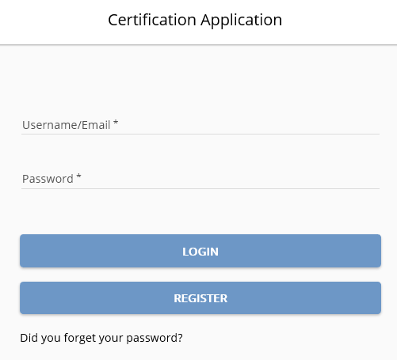
SWaM Certification Portal
  https://certification-app.sbsd.virginia.gov/

Slide 26
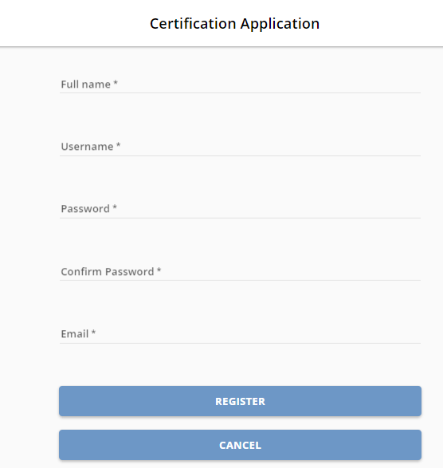
SWaM Certification Portal

Slide 27
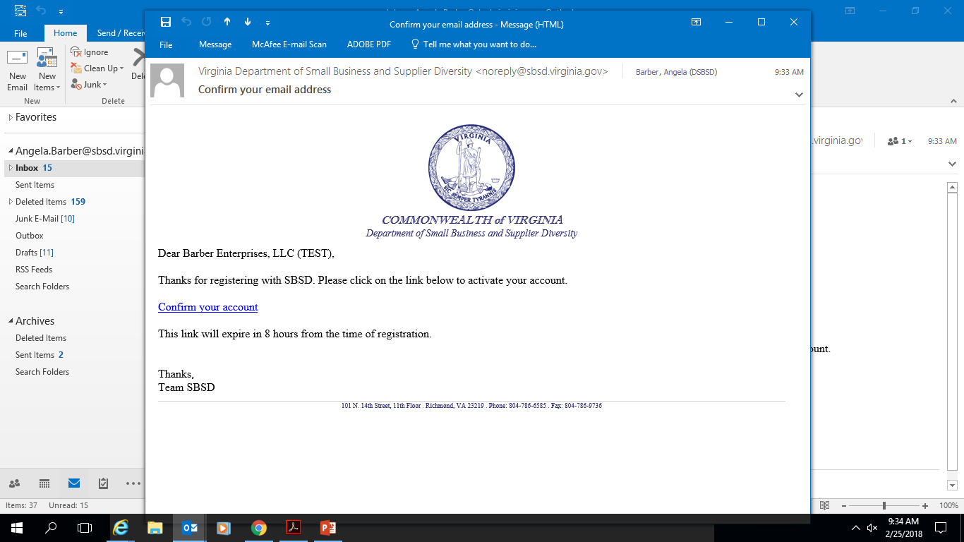
SWaM Certification Portal

Slide 28
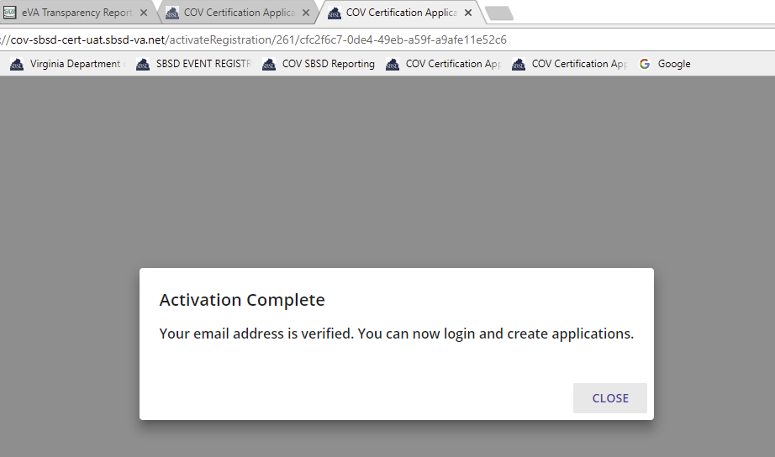
SWaM Certification Portal

Slide 29
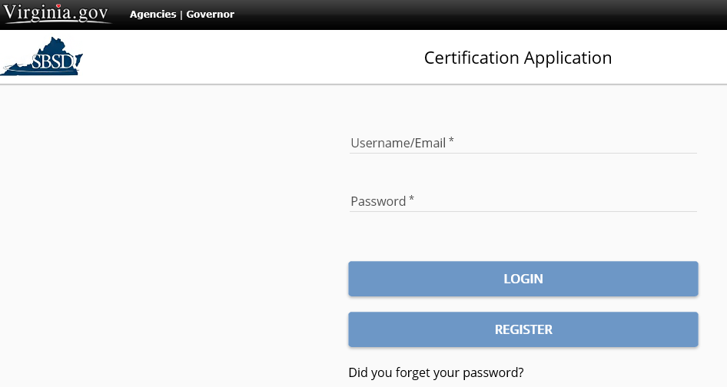
SWaM Certification Portal

Slide 30
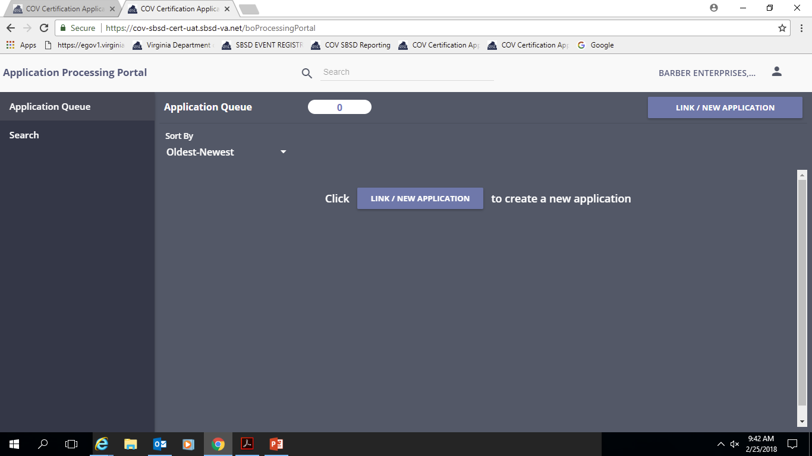
SWaM Certification Portal

Slide 31
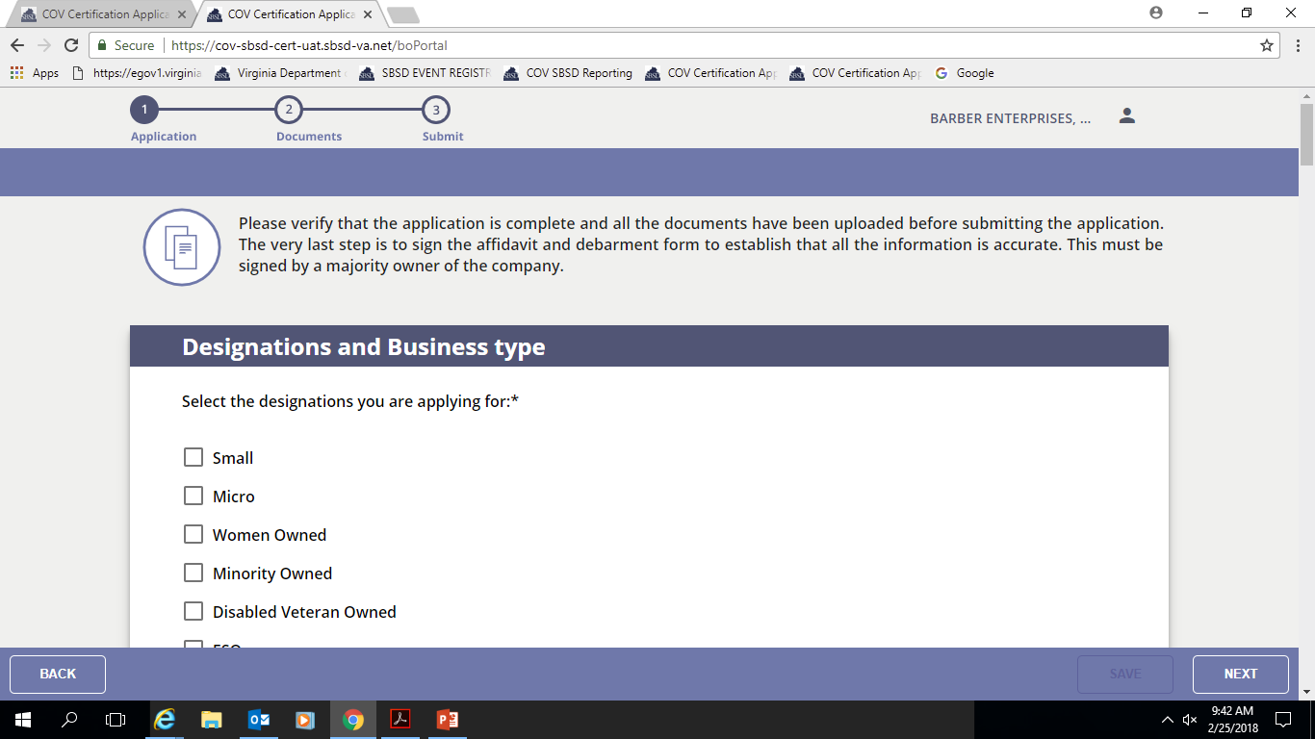
SWaM Certification Portal

Slide 32

SWaM Certification Portal

Slide 33
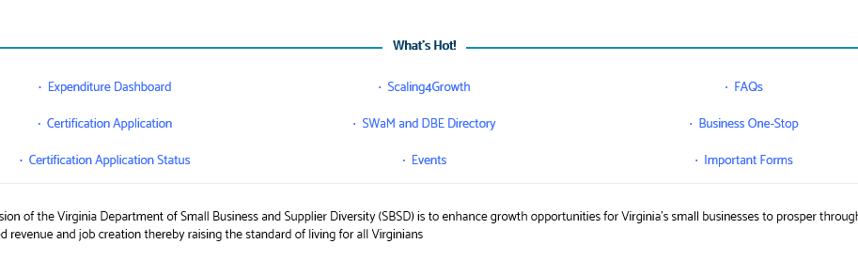
SWaM Certification Status
To check the status of your application, go to www.sbsd.virginia.gov

Slide 34
What is eVA?
Virginia’s eProcurement Portal
The tool used by the Commonwealth
for all
purchasing activity.
245+ state agencies, colleges & universities
770+ local governments
13,000+ eVA Users
Announce bidding opportunities
Get quotes
Place orders for goods/services

Slide 35
What you need to register…
Federal Employer Identification Number (EIN)
W-9 form
Commodity Codes

Slide 36
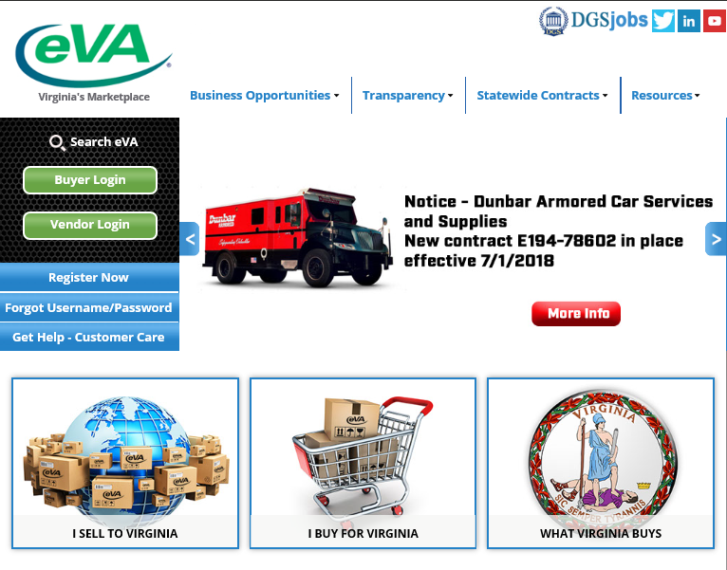
www.eva.virginia.gov

Slide 37
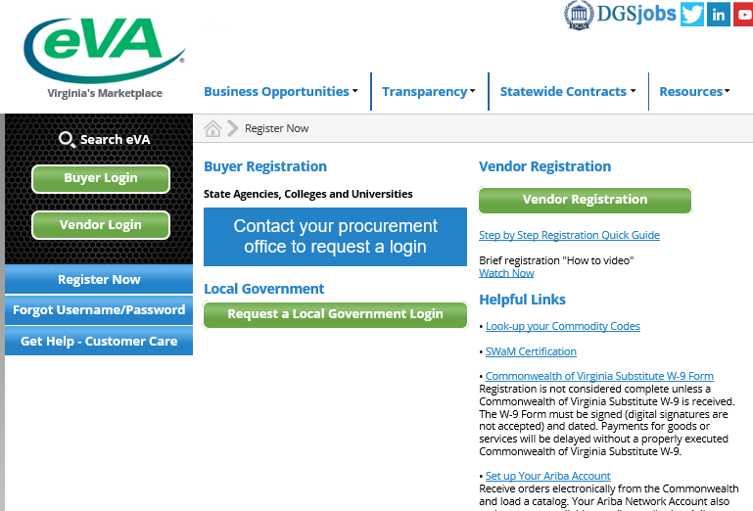
www.eva.virginia.gov

Slide 38
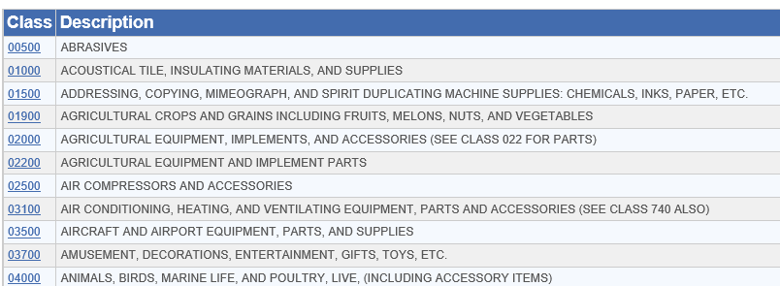
NIGP Codes
Commodity Codes
Describe your products/services
Tell eVA Buyers what you sell
Match you with bid opportunities

Slide 39
Questions with eVA …
eVA Customer Care 1-866-289-7367
or
eVACustomerCare@dgs.virginia.gov

Slide 40
Resources
One on One Business Counseling
To book appointment email at Ramain.gohar@sbsd.virginia.gov
SWaM lab
3rd Annual Blue Ridge Sales Conference– March 2022 at Radford University

Slide 41
THANK YOU
QUESTIONS ?

