Slide 1





Starting a Business
November 2, 2022
Presented by:
Christine Kriz, MBA
Laurel Ridge Community College
SBDC Director

Slide 2
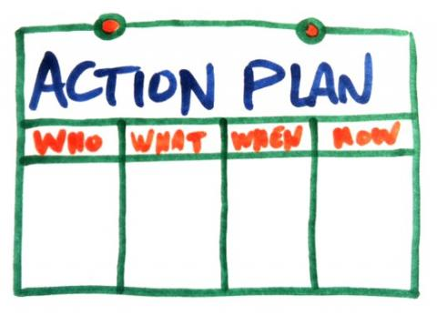
Our Agenda
Step 1: Key Considerations
Step 2: Customer Validation/Discovery
Step 3: Why a Business Plan
Step 4: Choose a Business Structure
Step 5: Register Your Business
Step 6: Finance Your Business
Step 7: Set up Bank Account/Insurances
Step 8: Taxes and Fees

Slide 3











EMPOWERING ENTREPRENEURS
Training
Advising
Resources
Laurel Ridge SBDC is hosted by Laurel Ridge community College and funded in part through a cooperative agreement with the U.S. Small Business Administration, George Mason
University, and
GO VIRGINIA, a state‐funded initiative administered by the Virginia Department of
Housing and Community Development (DHCD) that strengthens and diversifies Virginia’s
economy and fosters the creation of higher wage jobs in strategic industries.
laurelridgesbdc.org

Slide 4









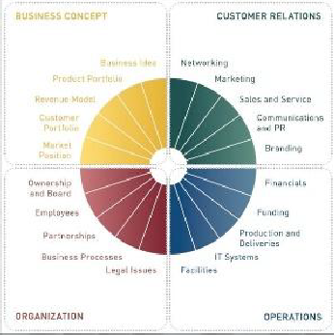





Our Services
Armed with LOCAL, STATE, FEDERAL assets:
Market and Financial Research
Technical Training
Strategic Planning Tools
Government Contracting
International Trade
Industry Specialists (retail, craft beverage, etc.)
Powerful Professionals
4

Slide 5
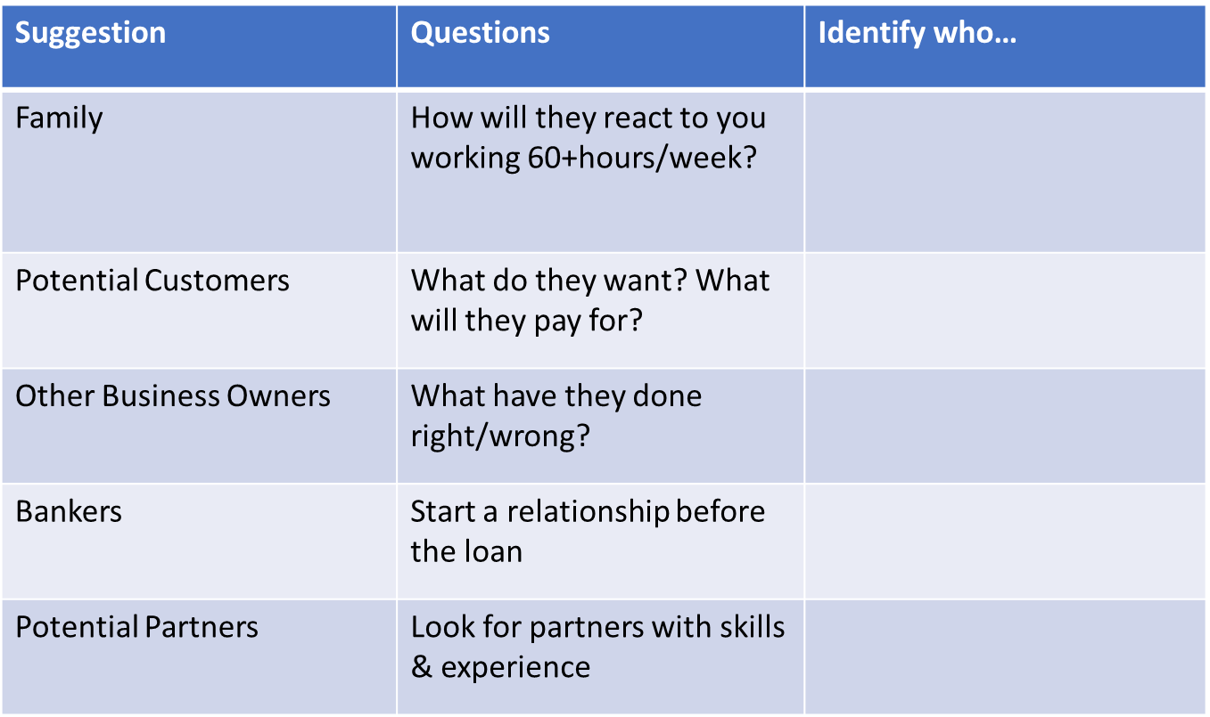
Key Considerations
Conversations

Slide 6

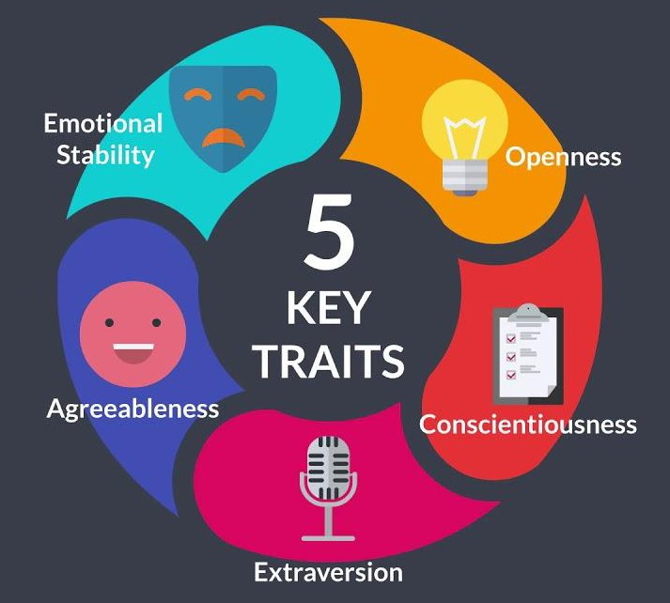
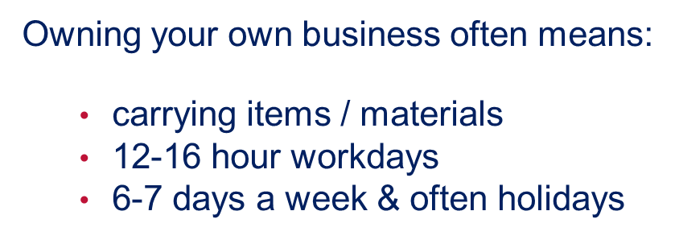

Key Considerations
Personal Assessment

Slide 7








Key Considerations:
Comfort Level with Risk
Operational Risk
Financial Risk
Supply & Delivery Logistics Recordkeeping & Accounting Information Management Production / Service Management
Cost of Capital Access to Capital Market Risk
Bank and Surety Support
4 Quadrants
of
Business Risk
Customer/Industry Changes Growth Strategy Branding/Image Competition
Employee Injury/Illness/Theft Third-party Liability
Natural Hazards Property Loss Cybersecurity
Hazard Risk
Strategic Risk

Slide 8
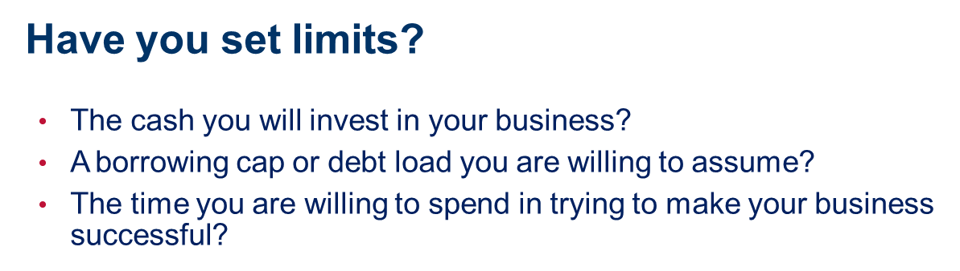
Key Considerations
Finances
After your household bills are paid, do you have adequate cash?
For 3-6 months of operation
Lenders will want 10-30% cash
Reserve funds or access to capital

Slide 9
Key Considerations
Finances
Are you prepared to:
Learn and plan for cash moving in and out of your business
Lower your standard of living for several months or several years if necessary
Pay a bookkeeper to help you
Possibly lose your savings or equity

Slide 10
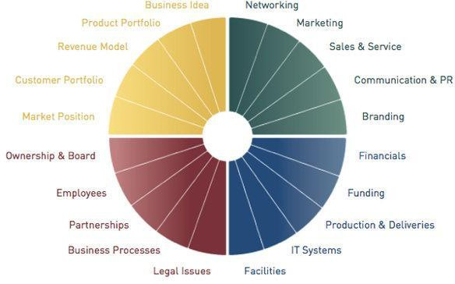
Key Considerations
What Skills Will Your Business Need?
19

Slide 11


Step 2: Customer Validation
You have a vision…
Your “baby” is a hypothesis at this point…

Slide 12




…that bothers your customer SO much they are willing to pay to make it better or solve it?

Slide 13
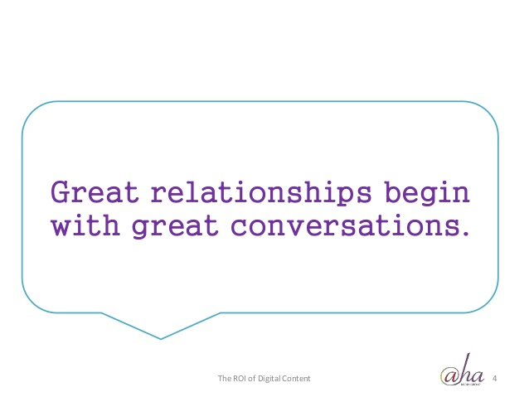
Customer Validation is
Finding your potential customers and having conversations with them

Slide 14

A short story about
Customer Validation

Slide 15

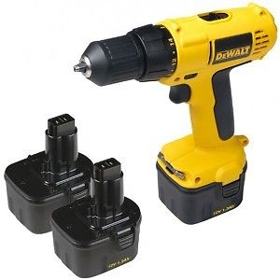


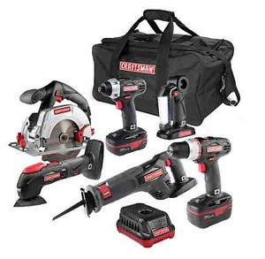
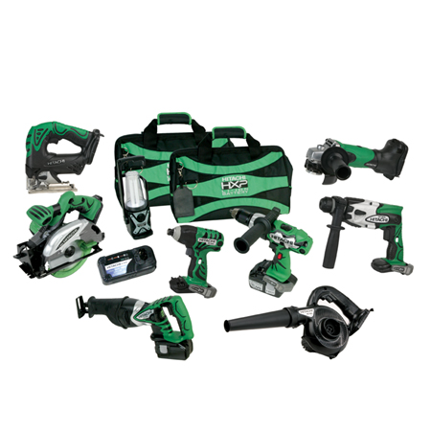
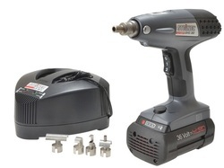


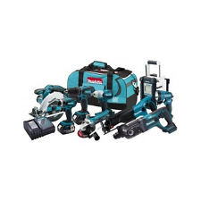
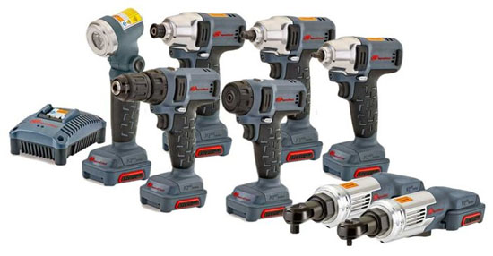


1992
1994
1997
So what could they do now?

Slide 16



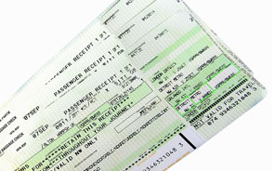




Slide 17
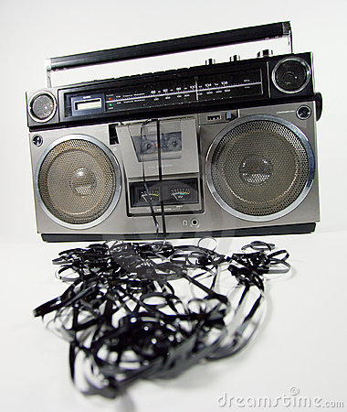

Notes:
In 1994 DeWalt introduced the cordless power tool product line.
Sold 1.5 million in the first year, making it the best product launch in the company’s history. Industry standard is 50,000

Slide 18
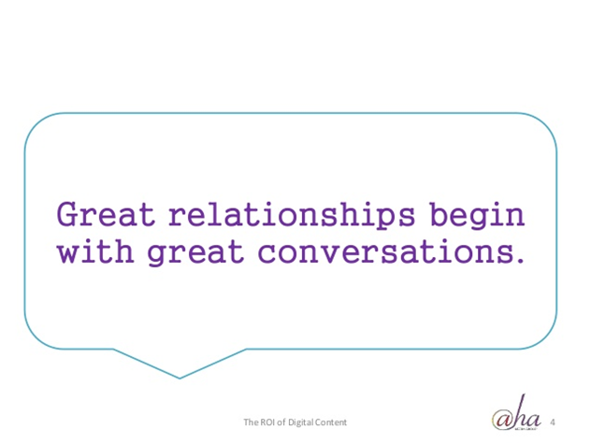

Questions to ask potential customers…
Walk me through the last time you purchased a ______
What could this business do better?
What’s missing from _______
Walk me through how you find a ______
What do you look for in a ___________
Describe how you choose_________
What was frustrating about finding a _________
What attracts you to ______________

Slide 19
Customer Validation is
Solving the RIGHT problem for the RIGHT customer! This is the key to your success!

Slide 20

Customer Discovery
Customer Discovery is the process of learning, who is a customer that cares enough to part with their money and give it to you.
Who are they?
Where are they?
How much do they buy?
How do you find and engage them?
What motivates them to spend money?

Slide 21

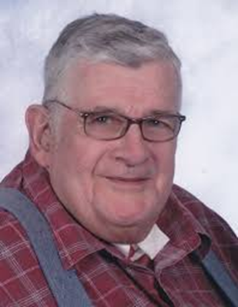






Who is your target customer?
How old are they?
What do they look like?
Male or female?
What do they like to do?
Where do they hang out?
What income do they make?
What profession are they in?
????????
Timeshare Tim

Slide 22
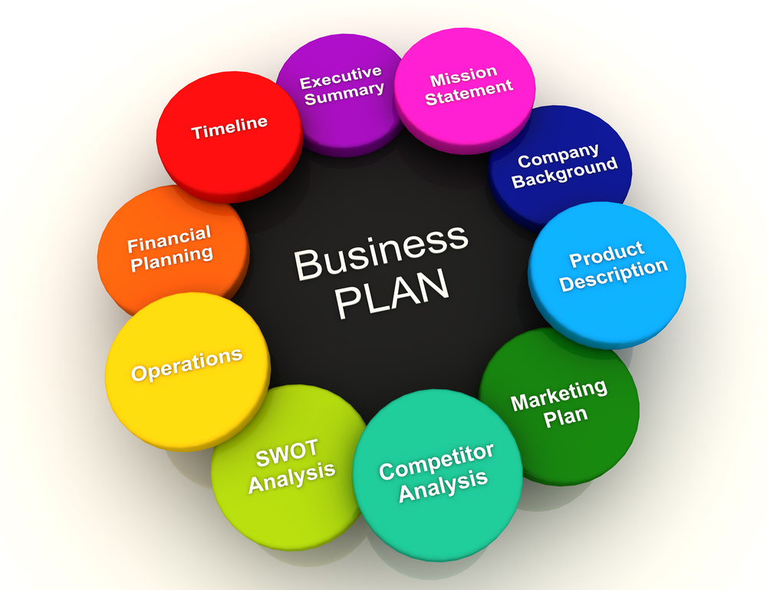
Step 3: Why a Business Plan?

Slide 23
Step 4: Business Structure

Slide 24
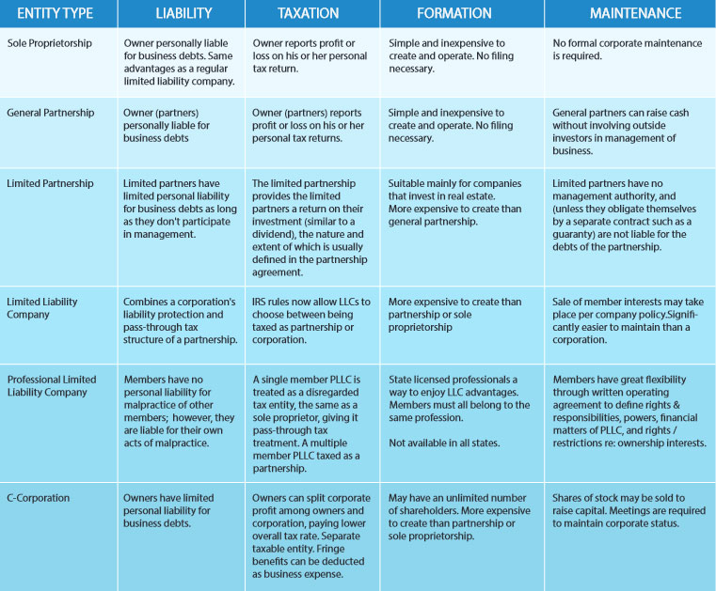

The 9 big C’s…of Business Success
Customer Credit Character Capacity Collateral Cash Flow Capital Conditions Commitment

Slide 25
Types of Business Ownership
Start New
Franchise
Part-Time
Family Business
Buy Existing
43

Slide 26

Choose route to business ownership
Incorporate or register fictitious name with SCC State Corporation Commission
Obtain EIN number from IRS: Internal Revenue Service
Register with VA Tax Department-(if collecting sales taxes)
Register with DPOR if have professional licenses
Register with Virginia Employment Commission if you will have employees
Obtain a business license from your locality at the Commissioner of Revenue office
  Town of New Market
  Strasburg
  Edinburg
  Winchester
  Check with your zoning officials
Start New
Franchise
Part-Time
Family Business
Buy Existing

Slide 27


Sources of Funds
Friends & Family
Loans or equity-based capital used early, often from supporters of the entrepreneur. May include crowd funding.
Cash Flow Tactics Optimizing use of accounts payable, receivable and supplier terms to improve accessible cash for operations.
Grants
Most for research and development or businesses located in target areas or working in targeted industries.
Equity Capital (Angel and Venture) Capital for businesses designed to achieve significant growth and exit in 3-10 years (depending on industry)
Strategic Alliances Sources of capital or access to assets of other companies
Loans & Lines of Credit
Useful for building a credit foundation for the business, for a wide range of business needs

Slide 28

The Cost of Capital
What is interest rate on borrowed money?
Will credit cards be used? If so, for what terms do you qualify: rate and lending limit?
If a relevant what is cost to you of using third party processors or payment processors?

Slide 29

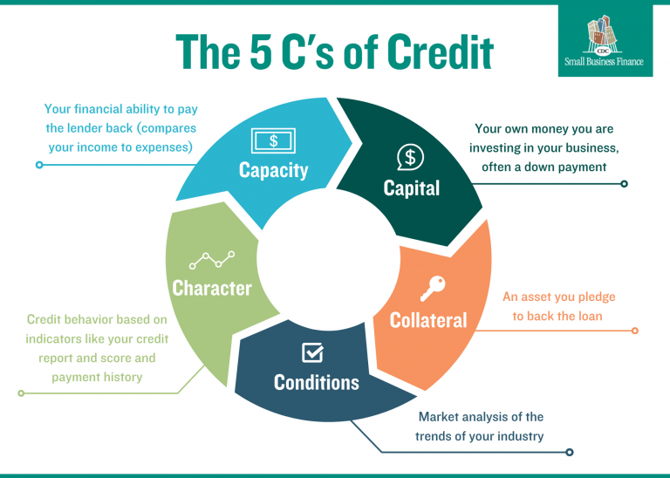
Credit
Character
Collateral
Capacity
Cash Flow
Capital

Slide 30
Shenandoah County IDA
Small Business Loan Program
The Small Business Loan Program is designed to fill the financing gap between private debt financing and private equity.
Eligibility requirements:
• Must be a U.S. citizen or permanent resident 18 years or older; the location of your business is or will be in Shenandoah County or one of the Towns within Shenandoah County.
• Must be a small business employing fewer than 50 employees and under $1 million in annual revenue
• Be able to inject new cash equity into the project; and
• Provide a first lien on the assets purchased with the loan proceeds, however, a subordinate lien position will be considered, if required by the primary lender.

Slide 31
Shenandoah County IDA
Small Business Loan Program
Loan funds can be used for:
Acquiring land and buildings
2. Leasehold improvements or expansions
3. Purchase and installation machinery
4. Equipment purchases
5. Technology infrastructure
6. Permanent working capital (some restrictions)
Loan funds cannot be used to:
1. Subsidize a business that is able to obtain financing for the project at reasonable terms from conventional sources
2. Refinance or restructure a bank’s existing debt
3. Compensate for fundamental business weakness as determined by the IDA
4. Provide for short-term working capital

Slide 32
Shenandoah County IDA
Small Business Loan Program
Terms of Loan:
Minimum: $20,000.00
Maximum: $99,000.00
Terms: Maximum: 7 years
Interest Rate: Determined by the Market

Slide 33
Shenandoah County IDA
Small Business Loan Program Criteria
The loan review committee will consider the following when reviewing your application:
Business Plan
Collateral: Please provide clear collateral for securing the loan (i.e. vehicles, business assets, equipment, machinery, and available personal assets).
Equity: Attach information regarding the forms of equity you will or have provided to your business. This can either be in the form of cash or in-kind contributions.
Credit History: Your credit history will be reviewed as part of the application process.

Slide 34
Shenandoah County IDA
Small Business Loan Program Criteria
Contact person: Jenna French
Location: 600 North Main Street, Suite 101 Woodstock, Virginia, 22664
Phone: 540-459-6227
Email: JFrench@shenandoahcountyva.us
Application Fee: $50

Slide 35
Step 7: Set Up a Bank Account
You will most likely need:
Employer Identification Number (EIN)
Your business's formation documents
Ownership agreements
Business license

Slide 36
Step 7: Set Up a Bank Account
Here are things to consider:
Introductory offers
Interest rates for savings and checking
Interest rates for lines of credit
Transaction fees
Early termination fees
Minimum account balance fees

Slide 37
Step 7: Set Up a Bank Account
Here are things to consider:
Introductory offers
Interest rates for savings and checking
Interest rates for lines of credit
Transaction fees
Early termination fees
Minimum account balance fees

Slide 38
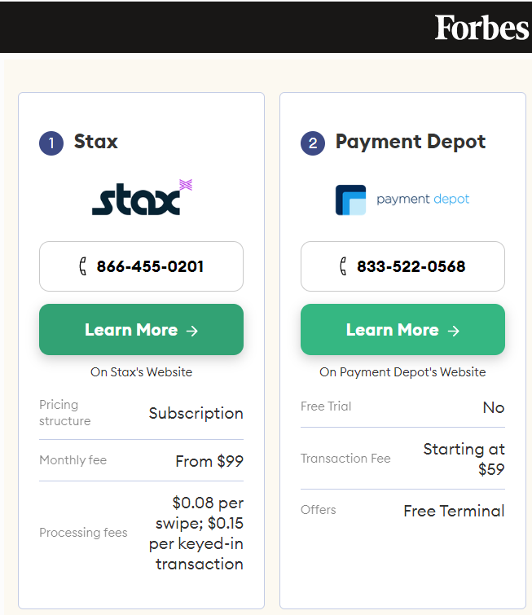
Step 7: Set Up a POS System
Best POS Systems of 2023
eHopper POS: Best for omnichannel businesses
Lightspeed POS: Best for customer loyalty
Clover: Best for integrations
Square POS: Best for businesses on a budget
Toast: Best for restaurants
Shopify POS: Best for retail businesses
KORONA POS: Best for no transaction fees
PayPal POS: Best for no monthly fee
Aloha Cloud: Best for next-day payments
https://www.forbes.com/advisor/business/software/best-pos-system-for-small-business/

Slide 39
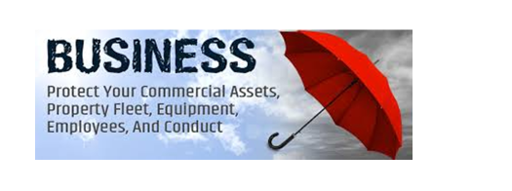

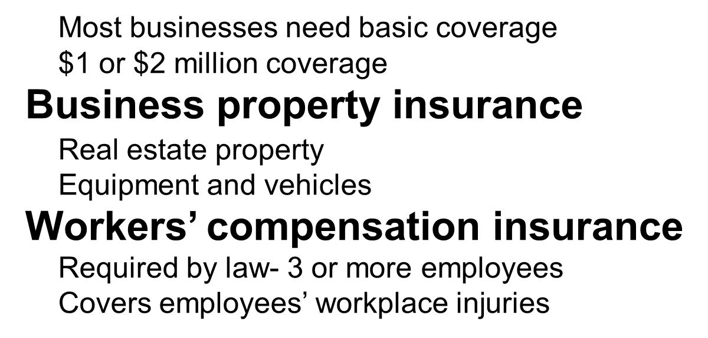
Step 7: Insurance

Slide 40
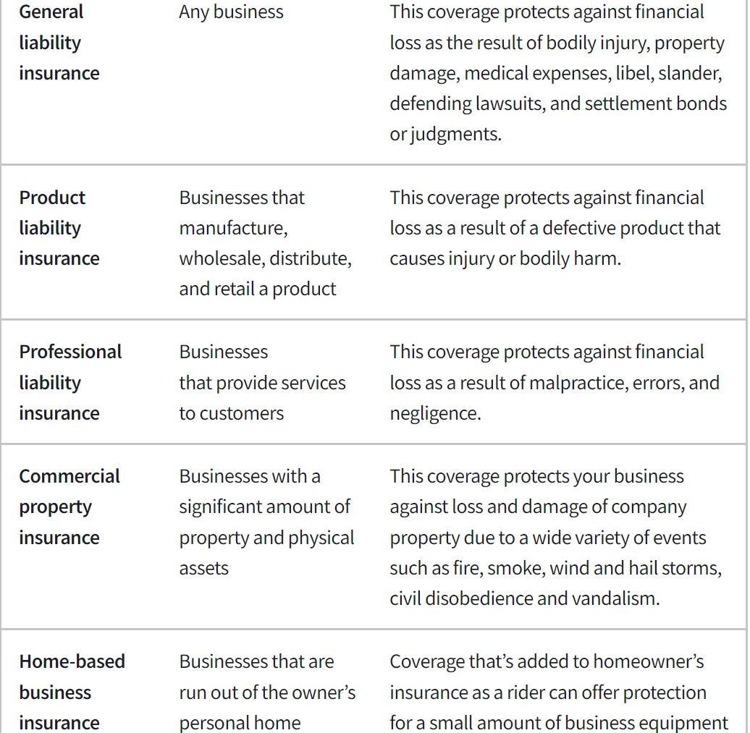
Step 7: Insurance

Slide 41



Taxes and Fees
Social Security and Medicare
Federal & State Income Tax Withholding VA Employment Commission (VEC)
Sales and Use Taxes Product Sales in State Local Meal & Sales Taxes

Slide 42


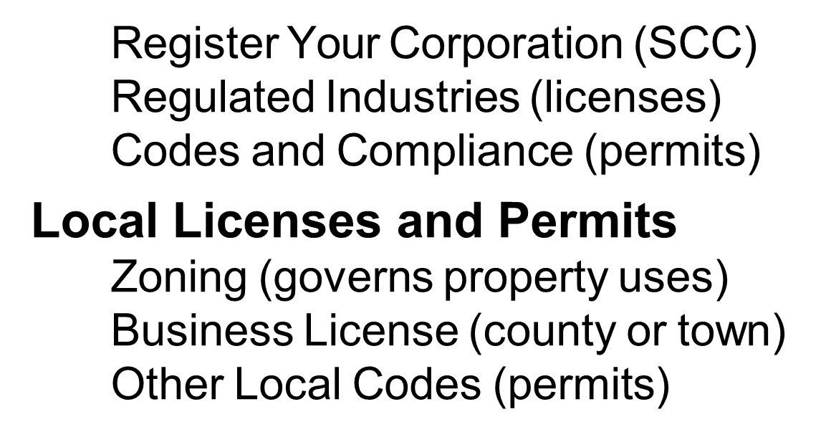

Slide 43

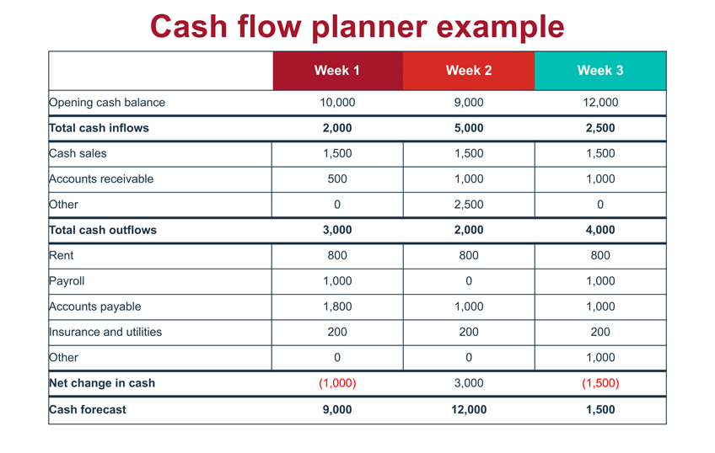




Slide 44
Next Steps
Personal Assessment – Am I Ready?
  Financing = $10-30% cash & collateral
  Credit Score 680+
Work the numbers
  Figure out start-up costs
  Project Monthly Business Revenue
  Project Monthly Expenses
  Computer your Break-Even Point
  Income = 1.25 x Expenses
Customer Discovery – Get out and talk to people
Work on Business Plan

Slide 45

Questions

Slide 46
Laurel Ridge Small Business Development Center
540-868-7094
laurelridgesbdc.org or ckriz@laurelridge.edu
Shenandoah County Chamber
Shenandoah County Economic Development

