Slide 1

GETTING PLUGGED
INTO VIRGINIA TOURISM RESOURCES
October 2023
Notes:
Going to share practical takeaways for small businesses including (1) first steps for getting connected (2) next steps for enhancing efforts (3) ways to stay connected with your partners

Slide 2


DESTINATION & BUSINESS DEVELOPMENT
POWER UP YOUR BUSINESS
Notes:
At VTC, we are in the business of destination development

Slide 3

DESTINATION DEVELOPMENT
With a dedicated staff comprised of seasoned tourism professionals, Partnership Marketing focuses its efforts on developing and marketing vibrant communities.
Goal: Help Virginia communities maximize their tourism potential.
POWER UP YOUR BUSINESS

Slide 4

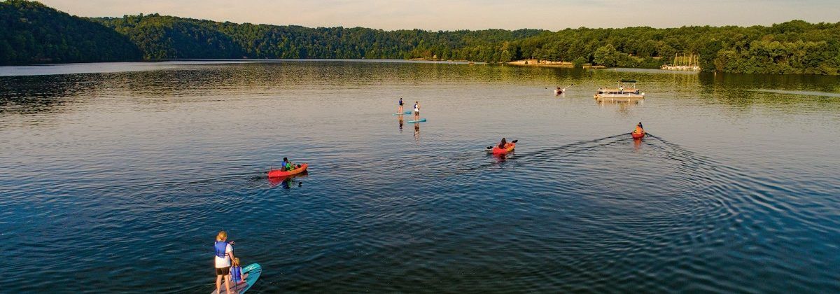
DESTINATION
DEVELOPMENT
https://vatc.org/partnershipmarketing/
MAXIMIZING TOURISM POTENTIAL
THREE KEY RESOURCES
Developing and marketing vibrant communities
Contributing to the livelihood of communities we serve
Business Development
Tourism Product Development
Funding Assistance
Industry Liaisons
Strategic Tourism Planning
Tourism Business Development
Cooperative Partnership Marketing Opportunities

Slide 5
VTC RESOURCES FOR BUSINESSES
POWER UP YOUR BUSINESS

Slide 6
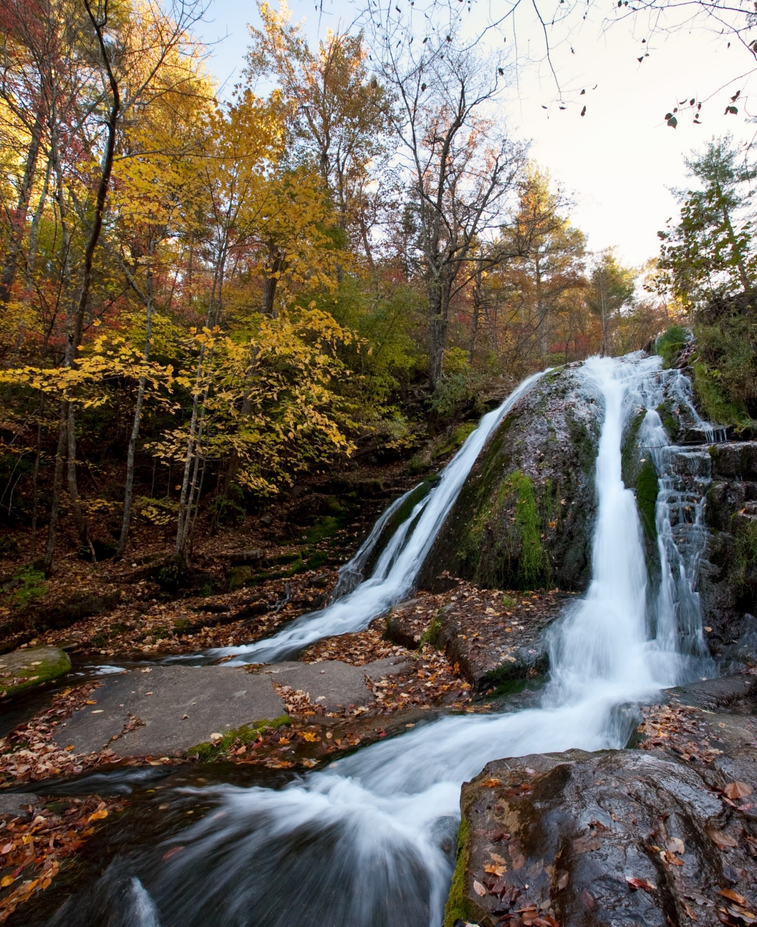

PARTNERSIHP MKT
& ADVERTISING
PLACEMENT
29 REST AREAS, 12 WELCOME CENTERS
AUDIENCE
33M VISITORS
3 million visited welcome centers in 2022
31 million visited safety rest areas in 2022
OPPORTUNITIES
Brochure distribution Pop up table banners
Small and large advertising panels Entrance rugs
Backlit advertising panels Special event kits

Slide 7
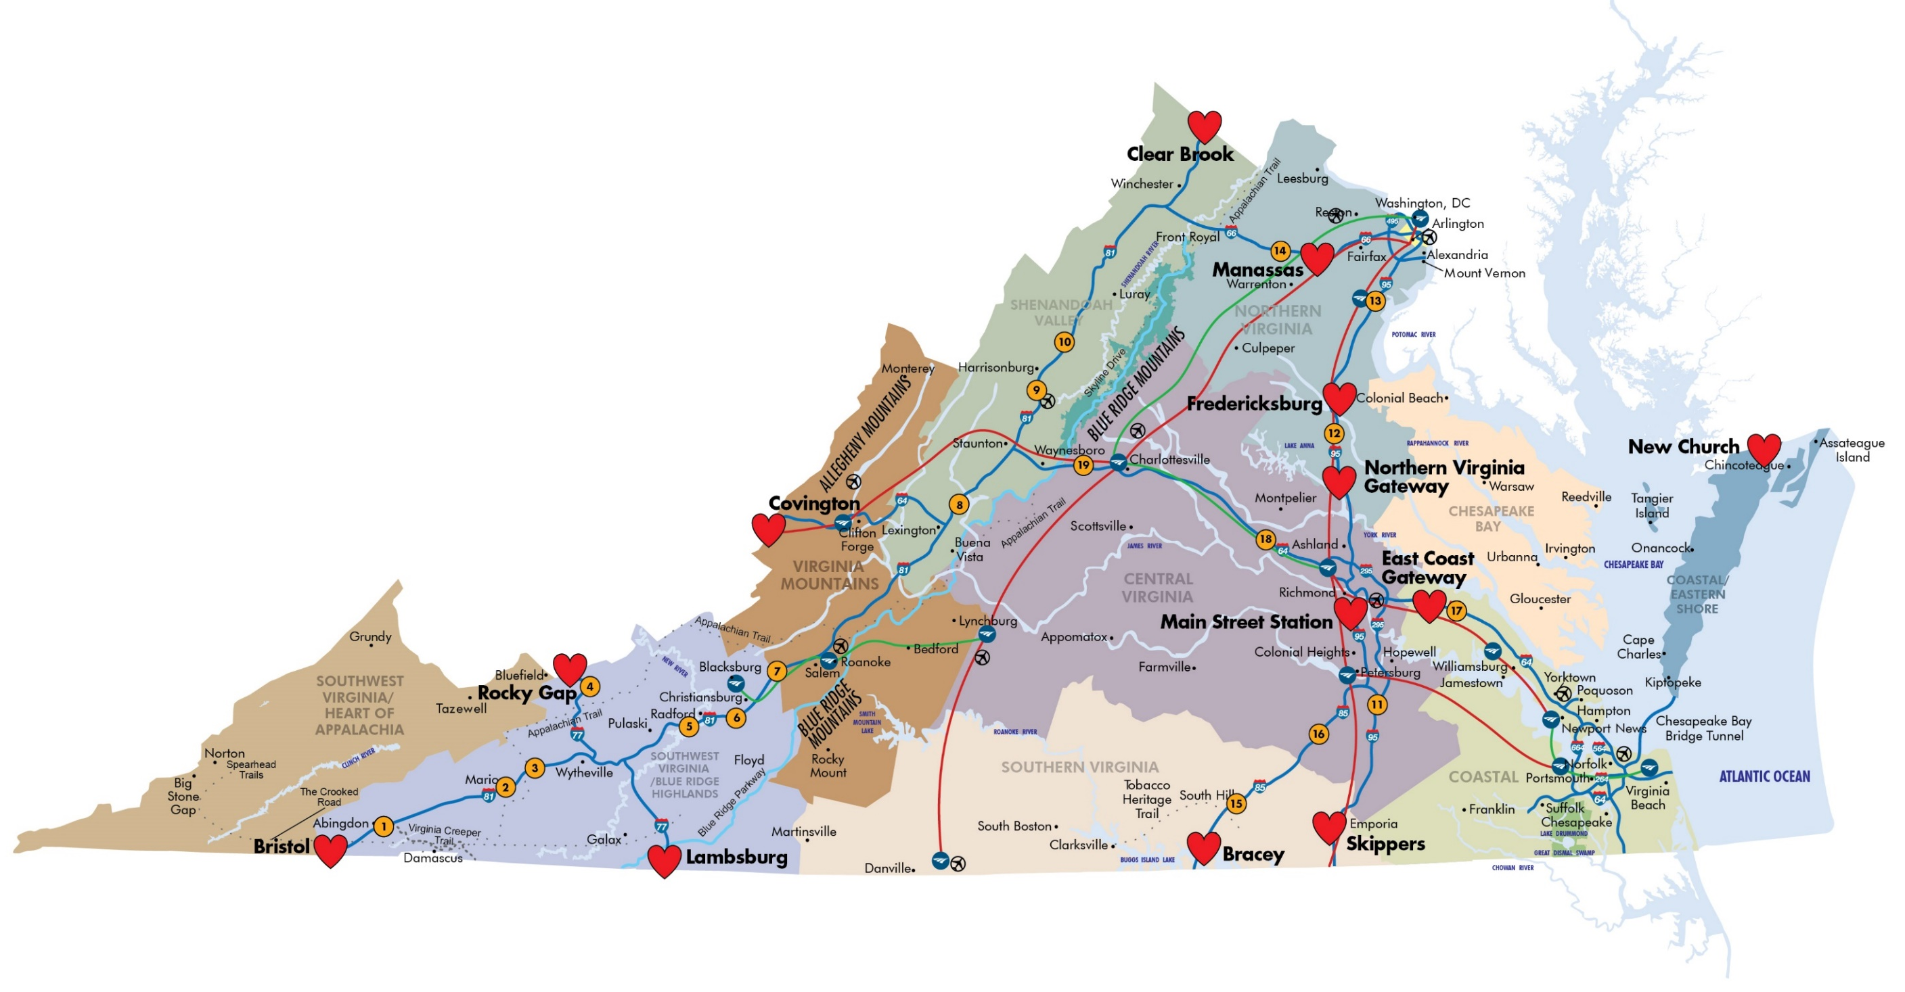

VIRGINIA’S WELCOME CENTERS

Slide 8
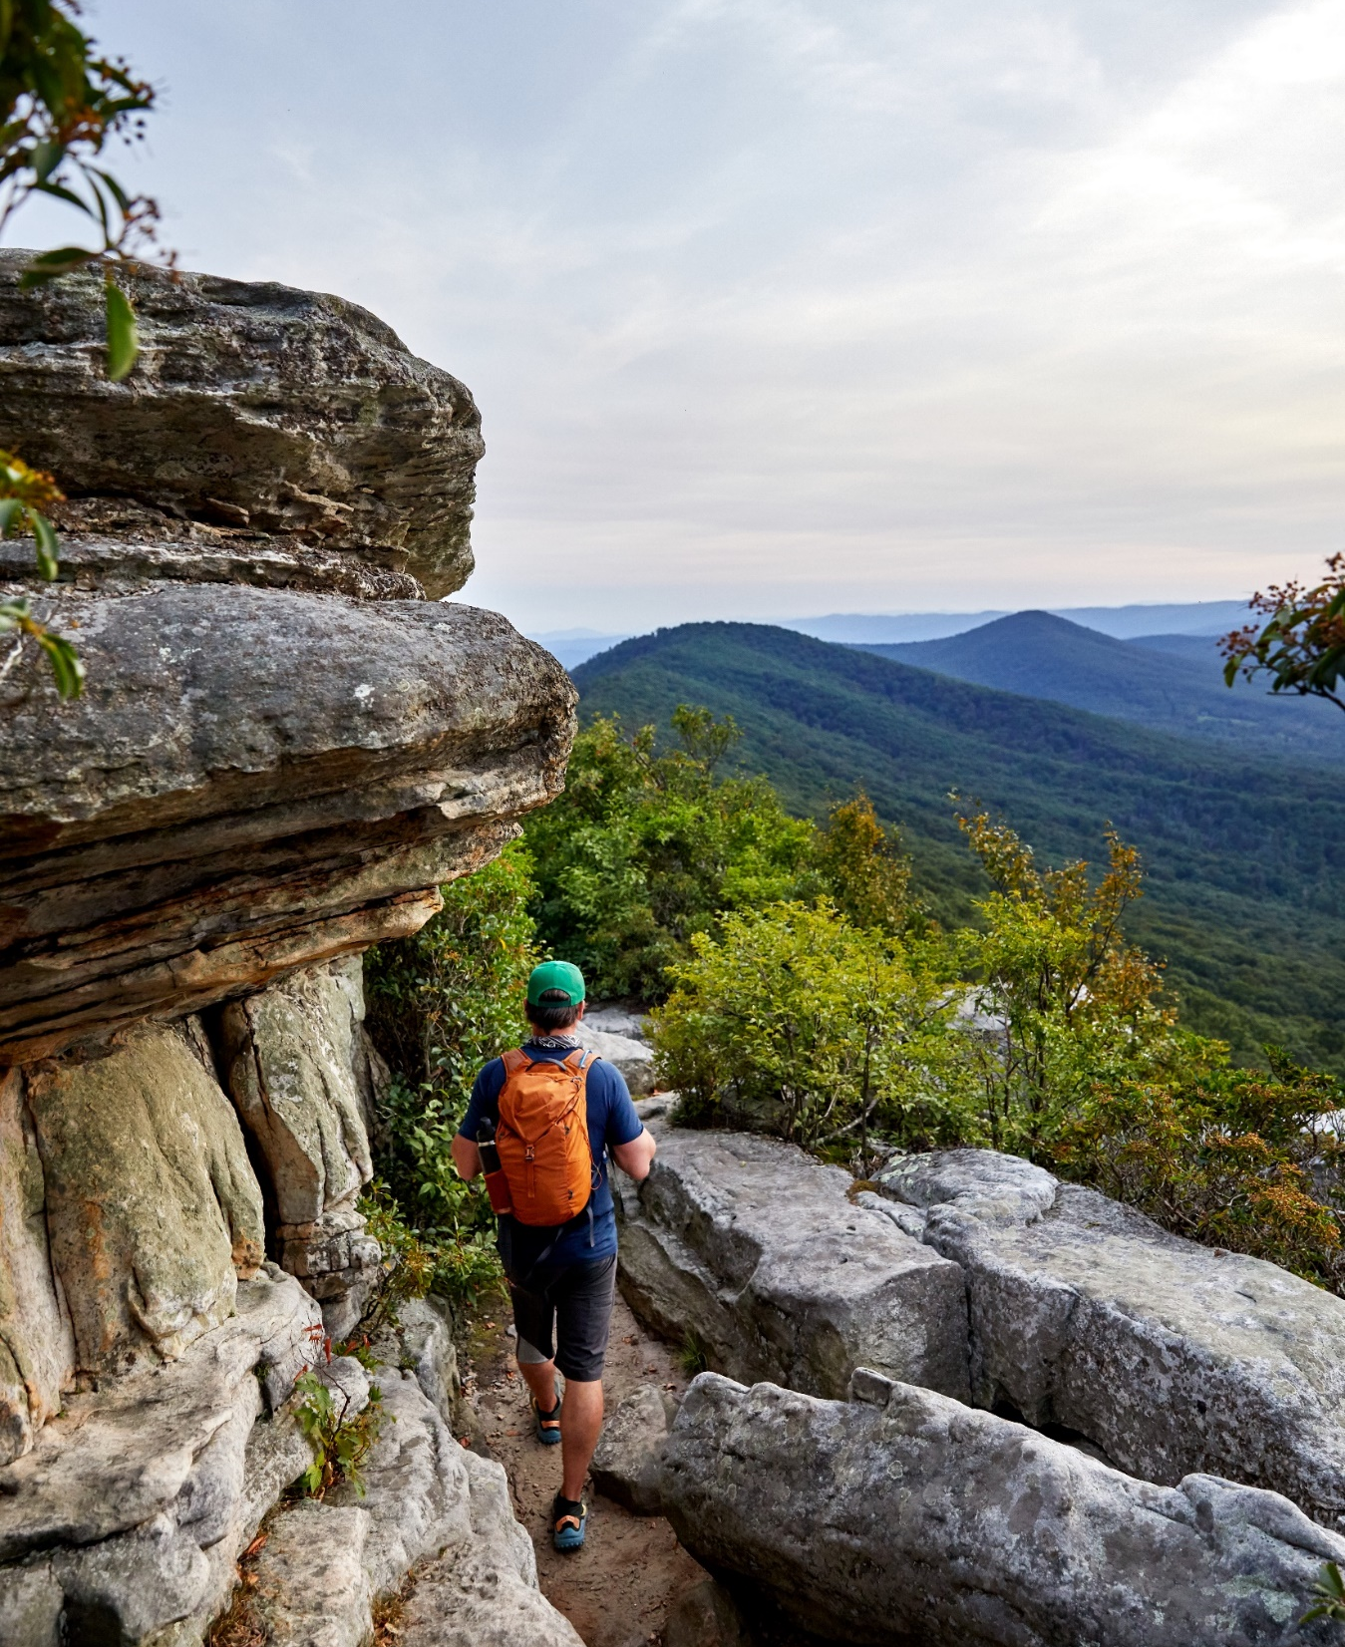
GRANTS
CALENDAR
EARLY 2024
Marketing Leverage - Early 2024
Special Events and Festivals - Early 2024
DMO Marketing Grant - Early 2024
LATE 2024
VA 250 - Spring and Fall 2024
Microbusiness MLP – Fall 2024
https://vatc.org/grants/ https://vatc.org/mmlp/

Slide 9
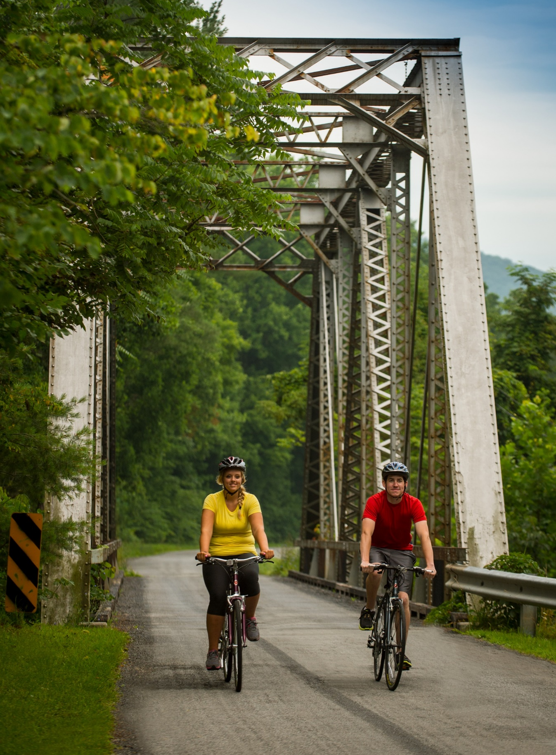
VA1 GOVERNOR’S
TOURISM SUMMIT
NOVEBMER 12-14
Get in the Game! VA1 is a valuable opportunity to network with your peers and celebrate tourism in the Commonwealth.
VA1 will be held at the Greater Richmond Convention Center in Richmond, VA. Lodging will be available at the Richmond Marriott for $175/night.
TOPICS INCLUDE:
Driving Value Based Outcomes
Digital Marketing 201
Sports and Recreation Tourism Panel
Building Data Driven Video Strategies

Slide 10
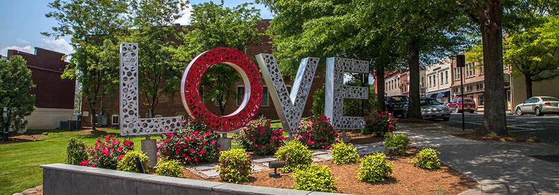
LOVEWORK
REIMBURSEMENT
REIMBURSEMENT: $1500
BENEFIT
Leverage the brand strength of Virginia is for Lovers to draw visitors to your business and promote your own messages and unique destination
PROCESS
Review requirements and guidelies
Complete an application
Receive approval
Begin building your LOVEwork!
https://vatc.org/advertising/loveworkreimbursement/

Slide 12

GET CONNECTED
WITH BRANDING
https://vatc.org/advertising/brandinitiatves/
BENEFIT: Gain recognition and grow awareness in new and existing markets
MESSAGING: Virginia is for…
MUSIC
WINE
CRAFT BEER
OUTDOOR
HISTORY
FOOD

Slide 13
STAY CONNECTED
POWER UP YOUR BUSINESS

Slide 14

ORIENTATION
SESSIONS
UPCOMING DATES
2024 dates will be announced soon
Learn about VTC’S marketing opportunities that can increase visitation to your small business, community, or events
SESSION DETAILS
Virtual, interactive events with VTC staff and industry partners
Three consecutive mornings from 9:00am-12:00pm
No charge!
https://vatc.org/partnershipmarketing/orientations/

Slide 15
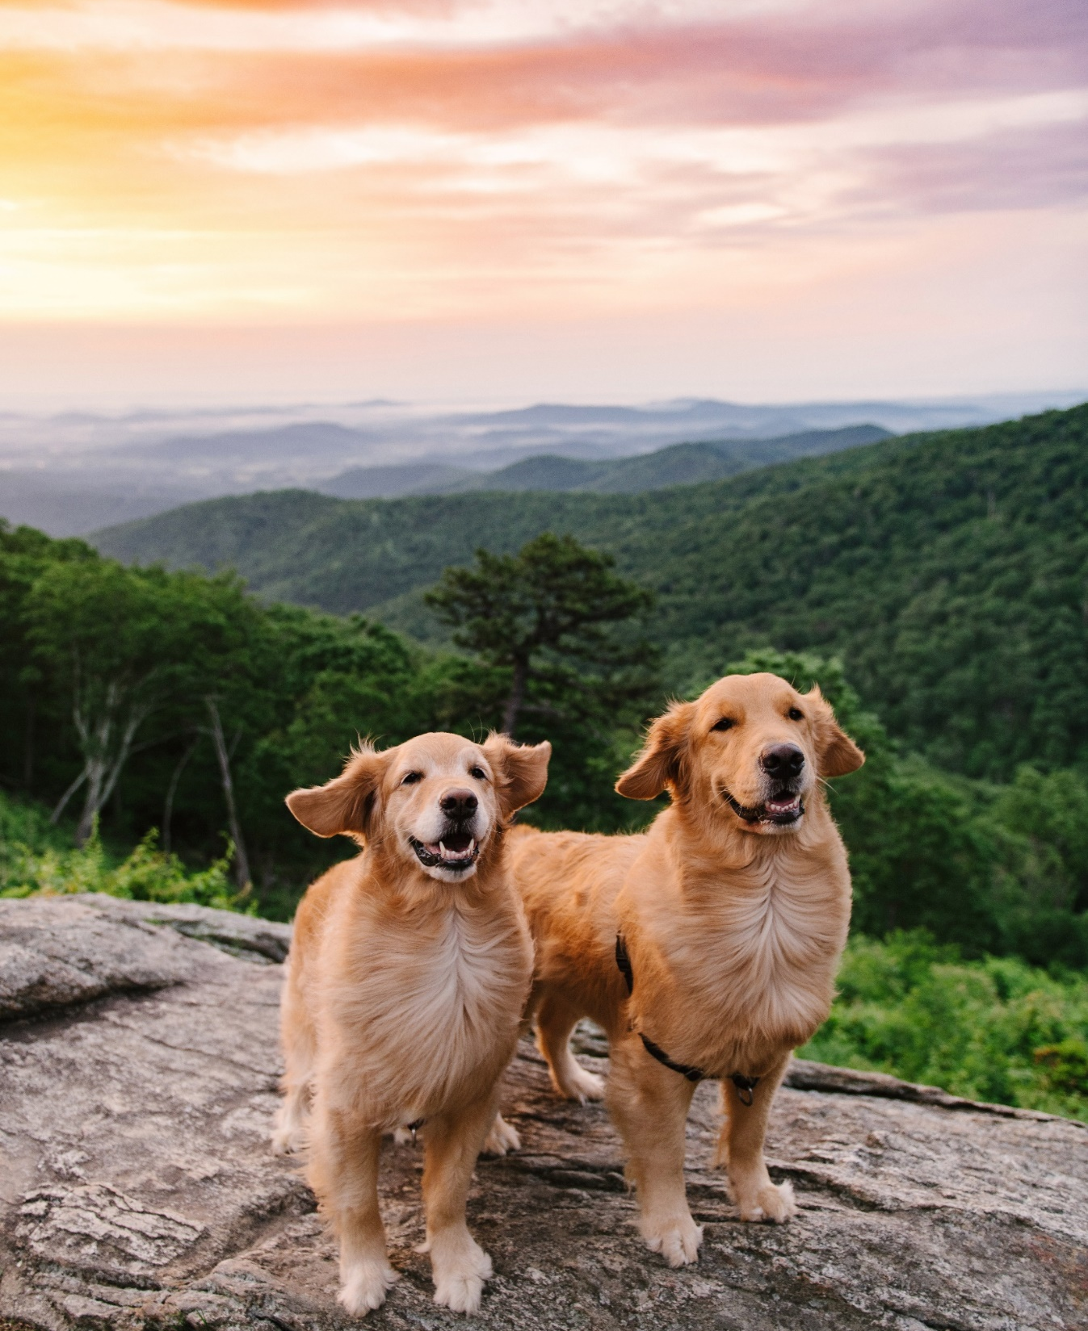

CONNECT WITH
YOUR DDM
Connect with your Destination Development Manager
Schedule a one-on-one meeting to discuss VTC services and programs
Build a relationship with your Destination Development Manager – make sure to share updates for your region or business with them.
Ask your Destination Development Manager questions about strategic planning, technical assistance, product development guidance, cooperative marketing advice, partnership ideas

Slide 16

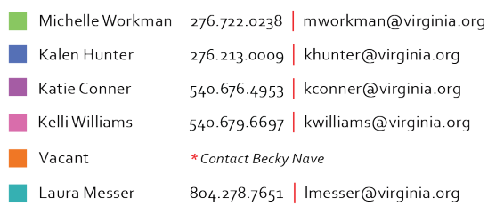
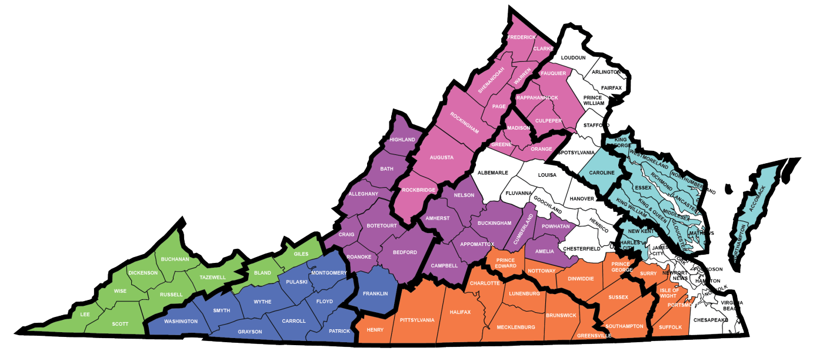
CONNECT WITH
YOUR DDM
https://vatc.org/partnershipmarketing/tdmanagers/
DESTINATION DEVELOPMENT TEAM
DESTINATION DEVELOPMENT MANAGERS

Slide 17

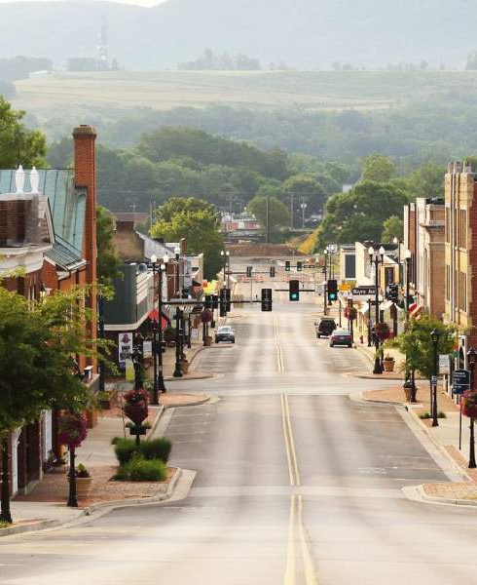
INDUSTRY
CONNECTIONS
LOCAL
Small Business Development Center (LRSBDC)
County Economic Development and Tourism offices
Chambers of Commerce
Shenandoah Valley Travel Association (SVTA)
People Incorporated
Virginia Restaurant, Lodging and Travel Association (VRLTA)
Virginia Tourism Corporation (VTC)
Virginia Welcome Centers
REGIONAL
STATEWIDE
Notes:
Partners in marketing, growth, development, and training

Slide 18

STAY CONNECTED:
PULSE OF VIRGINIA
https://vatc.org/about/newsletter-signup/
Stay up to date on the latest news, trends, grants, marketing and other essentials!

Slide 19
QUESTIONS?
POWER UP YOUR BUSINESS

Slide 20

THANK YOU!
POWER UP YOUR BUSINESS

