Slide 1

Getting Ready for Government Contracting
Presented by Lisa Wood
Statewide Director
lwood22@gmu.edu
Virginiaptac.org

Slide 2
Executive Order 13985
January 20,2021
It is therefore the policy of my Administration that the
Federal Government should pursue a comprehensive approach to
advancing equity for all, including people of color and others
who have been historically underserved, marginalized, and
adversely affected by persistent poverty and inequality.
Address any barriers to full and equal participation in agency procurement and contracting opportunities identified pursuant to section 5(b) of this order.

Slide 3
The Government Customer
DoD/Military
Federal Agencies
Prime Contractors
State
Local
Quasi Governmental (DOT)
Airport and Port Authorities

Slide 4
Self Assess
Do you owe back taxes?
Do you have a pending legal judgement with the Government?
Do you have a checking account?
Are you on the Governments excluded parties list?
Are you in default on student loans?
Are you computer savvy?

Slide 5
Past Performance
Either public or private sectors
Has revenue and years in business
At least two years of successful past performance

Slide 6
Strong Financials
Positive cash flow
Access to capital
year-over- year increases in revenue

Slide 7
Strategic Partnerships
Strong relationships forged by the firm with like minded businesses that may offer the same or complementary goods and/or services in order to support government contracts either as teaming, JV partners or Mentor Protégé
*participation in outreach and networking events

Slide 8
Well Ordered Office Space
Administrative staff
Organized filing system (Gov docs, financial statements, receipts, employee records, entity formation)
Approved Accounting system
Standard operating procedures (written)
Disaster Recovery Plan (written)
QA/QC plan (written)
Careful documentation of usernames, passwords and codes

Slide 9
The Government Language
Acronyms (know what they mean)
Codes (know your unique codes, NAICS PSC)
Databases (research all applicable)
Regulations (know your FAR)
Thresholds (know your limitations)
SB Programs (See if you qualify)
Procurement Instruments (GSA, BPO)
Websites (Every Prime and Agency has one)

Slide 10
Getting Started
EIN
UEI
Register in SAM
Complete the Dynamic Small Business Search
  Capability Narrative
  Keywords
  Past Performance
  Make sure your Website is Government Friendly
  Know your Resource Partners (Free)

Slide 11
Federal Agency Contracting Goals
Federal agencies have subcontracting goals
Statutory goals established by federal executive agencies for small business procurement
23% Small Business
5% WOSB (Women-Owned Small Businesses)
11% SDB (Small Disadvantaged Small Business/8(a))
3% SDVOSB (Service-Disabled Veteran-Owned Small Business)
3% HUBZone (Historically Underutilized Business Zones)

Slide 12
Federal Government Certifications
Formal Certification
HUBZone – 3% goal
8(a) Business Development – 12% goal
Self-Certification
Small Business
Small Disadvantaged – 12% goal
Women Owned – 5% goal
WOSB/EDWOSB
VOSB/SDVOSB

Slide 13
HUBZone
(Historically Underutilized Business Zones)
Must be a small business
Must be U.S. Citizen
Principal office, manufacturing or other facility must be located in a HUBZone
35% of the employees must reside in a HUBZone location
Must be a physical address, no virtual
3% Goal – bids are set-aside

Slide 14
HUBZone (continued)
Program information
Maps Section
Application
  https://www.sba.gov/contracting/government-contracting-programs/hubzone

Slide 15
8(a) Business Development Program
9 Year program
Must be a small business
Must be U.S. Citizen
51% ownership and day-to-day management by 8(a) qualified individual(s)
Must be BOTH socially and economically disadvantaged
  Socially disadvantaged: African American, Hispanic, Native American, Native Alaskan, Native Hawaiian, Iberian Peninsula, Asian, Sub-Continent Asia
  Economically disadvantaged: Personal net worth cannot be more than $850k going into the program (does not include the value of home or business).
Must be in business for 2 years (can request 2-year waiver but must show that you have generated revenue in your industry)

Slide 16
8(a) Business Development Program cont.
Program info:
    https://www.sba.gov/contracting/government-contracting-programs/8a-business-development-program
How to apply:
https://certify.sba.gov/
12% Goal – bids are set-aside
Sole source allowed with thresholds
    $ 4 million goods & services
    $ 7 million for manufacturing

Slide 17
Small Disadvantaged Business (SDB)
Must be a small business
51% Ownership and day-to-day management by SDB qualified individual(s)
Socially disadvantaged: same as 8(a)
Economically disadvantaged: net worth no more than $850k
Self-certified
12% Goal

Slide 18
Veteran Owned Small Business (VOSB)
Service-Disabled Veteran Owned (SDVOSB)
Veteran Small Business Certification (sba.gov)
Must be a small business
51% Ownership and day-to-day management by U.S. veteran(s)
Formal Certification VOSB/SDVOSB in SBA
Allows you to bid on SDVOSB set-aside solicitations, 1 year grace period
Verified through CVE grandfathered in and 1 year added

Slide 19
Women Owned Small Business (WOSB)
Economically Disadvantaged Women Owned Small Business (EDWOSB)
SBA Program
Pertains to certain NAICS codes
Upload documents in SBA Repository (beta.certify.sba.gov) including your certification from the Third party Certifiers!
Website: https://www.sba.gov/content/women-owned-small-business-program

Slide 20
Woman Owned Small Business (WOSB)
51% Controlled/owned/operated by a woman or women who are U.S. citizens
Holds the highest position in business
Makes the day-to-day business decisions
Ownership must be direct and not subject to conditions
Meet small business size standards for primary NAICS code

Slide 21
Economically Disadvantaged Women Owned Small Business (EDWOSB)
51% Controlled/owned/operated by a woman or women who are U.S. citizens
Holds the highest position in business
Makes the day-to-day business decisions
Ownership must be direct and not subject to conditions
Meet small business size standards for primary NAICS code
Personal net worth of less than $850k
Adjusted annual income of $400k or less
Market value of all assets does not exceed $6.5mil (including value of business and primary residence)

Slide 22
SBA’s All Small Mentor Protégé Program
Must be registered in the System for Award Management (SAM)
Both Protégés and Mentors are required to complete an online training module as part of the application process
Mentor-Protégé relationship should be established before starting this application – the ASMPP is not a matching program.
Only applications submitted through www.certify.sba.gov will be considered.
A sample Mentor/Protégé Agreement template is available at: https://www.sba.gov/contracting/government-contracting-programs/all-small-mentor-protege-program/how-apply

Slide 23
Assistance That Can Be Provided
Management and Technical Assistance
Financial Assistance
Contracting Assistance
Trade Education
Business Development Assistance
General and/or Administrative Assistance

Slide 24
FED BIZ OPPS
FedBizOpps (now part of SAM)
  Marketing research tool
  Shows contracts greater than $25,000
  Used for set-aside opportunities
  Used to gather information
  Sources Sought, RFI, Draft Proposals
  Create search filters
  https://sam.gov/

Slide 25
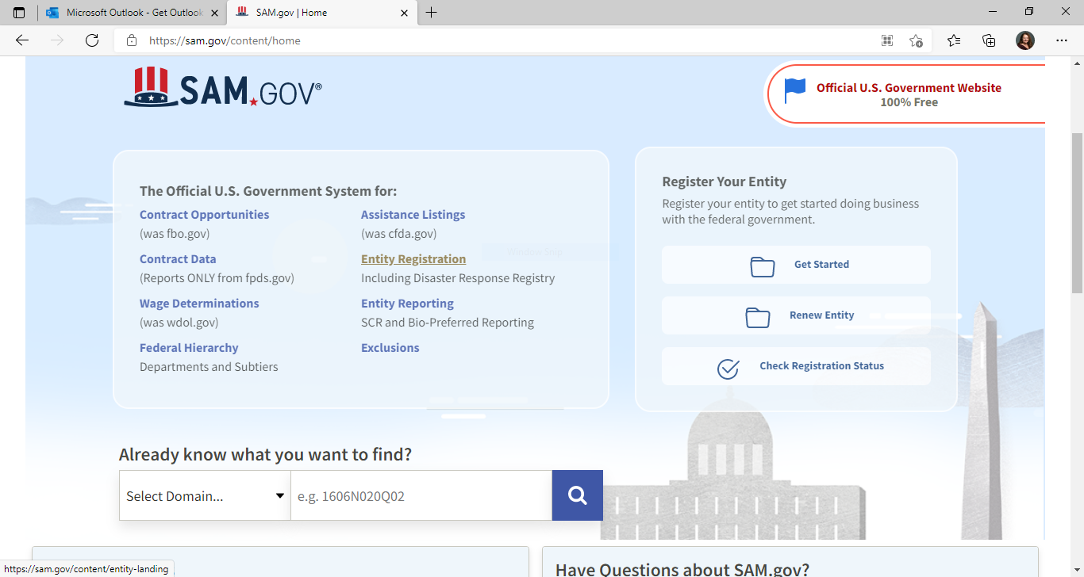

Slide 26
Market Intelligence
Know your competitors
Who is buying from them
What are their strengths, weaknesses
Review their brochures, websites, DSBS profiles (snoop)

Slide 27
Points to Ponder
The Government Buys Everything
Not every Government agency or Prime Contractor buys everything
Know Who buys what you sell

Slide 28
Target the Right Customer
Develop a Business and Marketing Plan Unique to Government Contracting
Who are your potential customers
What are their needs, challenges
Review websites
Know Your Limits
Know your customers regulations/procedures

Slide 29
Acquisition Forecasts
http://acquisition.gov/comp/procurement_forecasts/index.html
  Acquisition Forecasts (>$25,000)
  When they plan to purchase
  Points of contact
  Type of contracts
  Small business preference
  Also check Agency/Department/Prime Website

Slide 30
What the Buyer Wants to Know
Whether you can meet their needs
Can you solve their problems
Are you Responsible and Responsive
Company name, contact info, and capabilities-who you are and what you do
Past performance and previous customers
Your Socio-Economic status (last)

Slide 31
Capability Statement
Core Competencies
Differentiators
Past Performance
Relevant Company data
Just the facts
One page

Slide 32
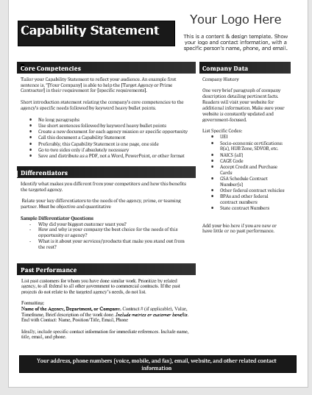

Slide 33
Marketing Avenues
Key- Network, Network, Network
Meet your buyers-if possible, establish relationships
Attend Conferences/ Workshops/ Industry Days/ Matchmakers
Check out Calendar Events
Participate in Gov Con Training

Slide 34
Email
  Short Sound Bites
  High Value Content
  White Paper Delivery
  Capability Statement Updates
  Professional: no gmail, aol, or yahoo accounts

Slide 35
Website
Most recent project/deal on front page
Keep website updated and relevant
Government Tab
Capability Statement PDF (link for printing)
Easy Navigation
Bullet Format
Past Performance/History

Slide 36
Marketing
Social Media
  LinkedIn Connections
  Twitter Contact
  Facebook Community
  Can ask which ones they use or visit

Slide 37
State Procurement
Not as complex as Federal
Register in eVA (or State equivalent)
Get SWaM certified (supplier diversity certification)
Elect option for Bid Match (if offered)
Participate in State Procurement Training!

Slide 38
Local Government
Not all use eVA or the State e-commerce site
Determine how they procure
Where and how they post opportunities
Local preference
Economic Development

Slide 39
In Summary
Establish past performance
Have a Capability Statement
Know who buys what you provide
Stay on top of market forecasts
Be where you can be found
Start Small and work your way up
Stay focused!

Slide 40


Slide 41
Questions?

